Slide 1
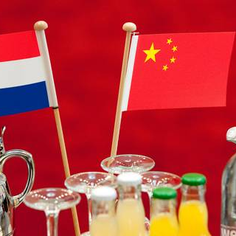

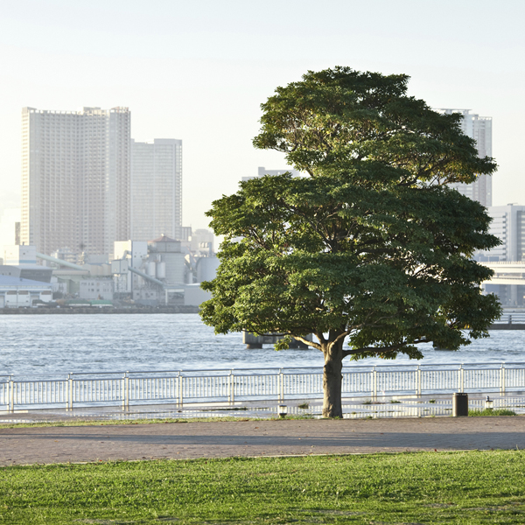
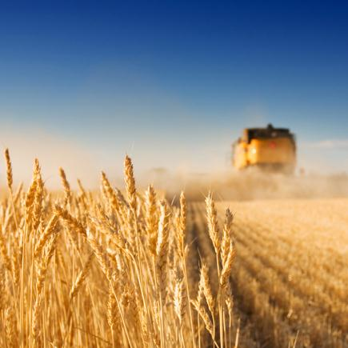
Success of the Agri-Food sector through
Public Private Partnerships
Prof. Dr. Martin Kropff
Rector Magnificus Wageningen University
Vice-chairman Wageningen UR

Slide 2
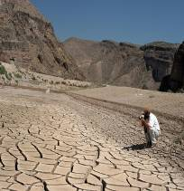
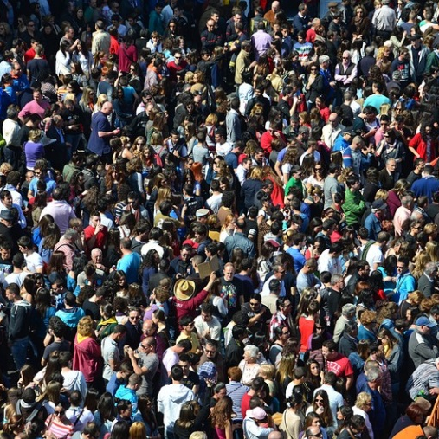
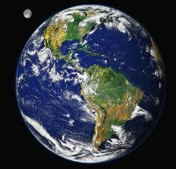

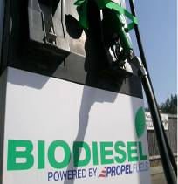
Global challenges
Climate change
Food security
Agri-food
Biodiversity
Food and health
Biobased Economy
Notes:
Biomassa (het agro-food complex) speelt een cruciale rol in de grote uitdagingen van vandaag:
Voedselzekerheid
- klimaatverandering (adaptatie en mitigatie)
- Zorg voor onze omgeving
- Voeding en gezondheid (Obesitas)
- De Biobased Economy: Bio-brandstof en biomaterialen.

Slide 3
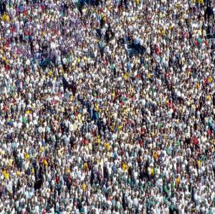

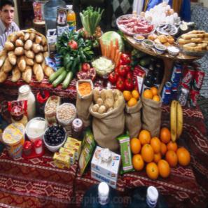
Two times...
More
Less
Better

Slide 4
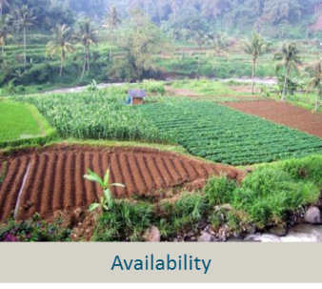
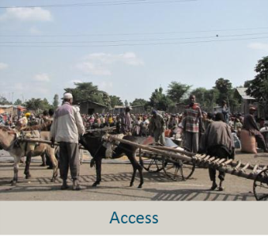
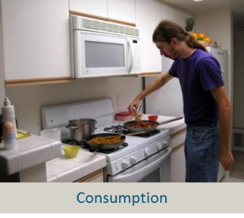
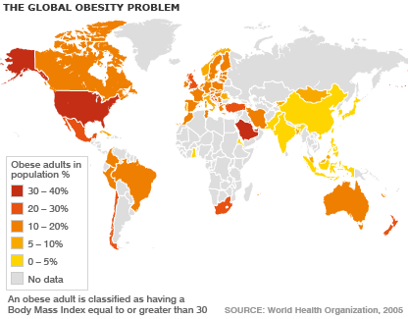
Nutrition security
Food availability (kcal/person/day)
4000
3760
3490
3000
2930
2908
2220
2000
1590
Situation today
  Enough production
  Unequal access
  Hidden hunger
  Overweight
Situation 2050
  70% more food needed
  by 2050 (FAO)
1000
0
Africa
Congo, Dem.
USA
The
China
Chile
Republic of
Netherlands

Slide 5
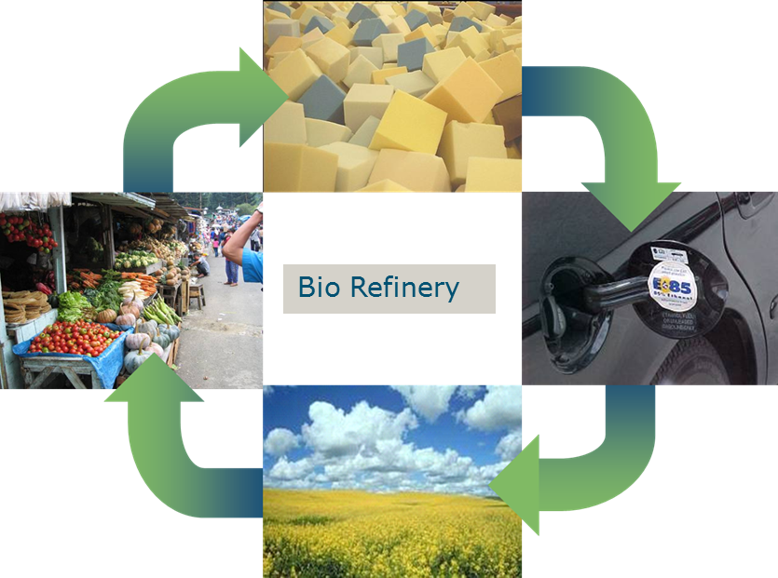
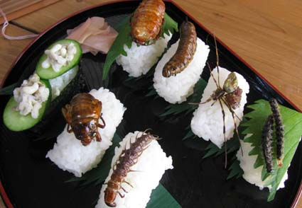
Nutrition security in 2050: more food
A higher production
  Sustainable Intensification
  System approaches
    Eco-system services
    Bio-economy
  Non-land use
Efficient food use
  Avoid losses and waste
  Alternative protein sources

Slide 6


Nutrition security in 2050: Utilization
Micro-nutrients
Healthy diets and consumers behaviour
Personalized food

Slide 7
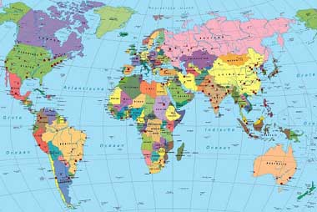
The Netherlands
World 2nd exporter Agrifood
  60% seeds horticulture
  85% seed potatoes
  2nd exporter onions after India
  Leading in food processing equipment
Trade leaders
  Main port to Europe
  2nd importer Palmoil and Soya
  Leading in flower business
World leading in Agrifood knowledge
Public Private Partnerships
NL approach: Guiding principles?

Slide 8

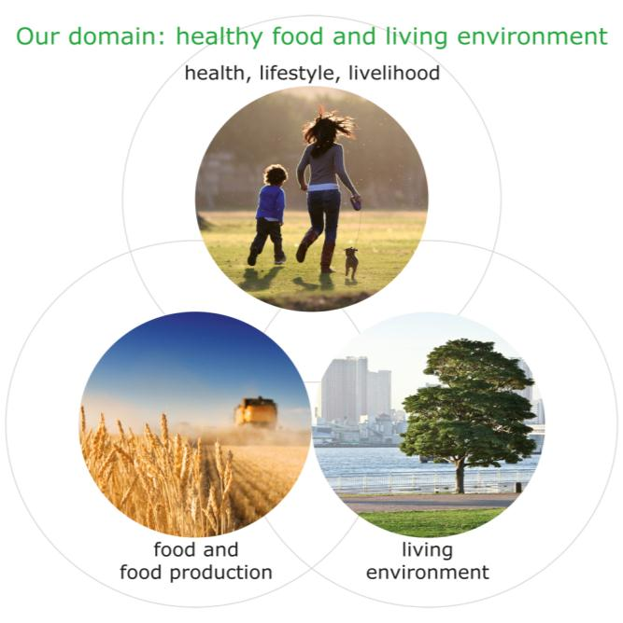
Wageningen UR domain

Slide 9

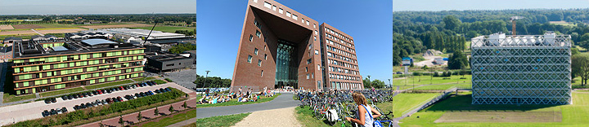
Wageningen UR (University & Research centre)
2 organizations:
  Wageningen University
  9 research institutes
MSc students from > 120 countries
2000 PhD students
Chinese students: 360 MSc, 125 PhD
Top 3 in domain worldwide
Strong in Public Private Partnerships

Slide 10
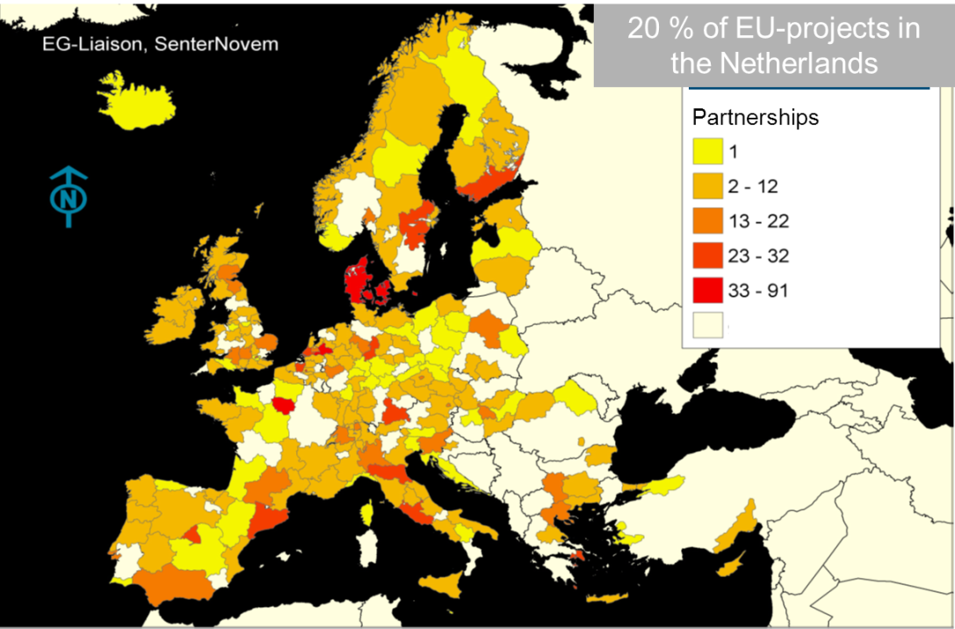
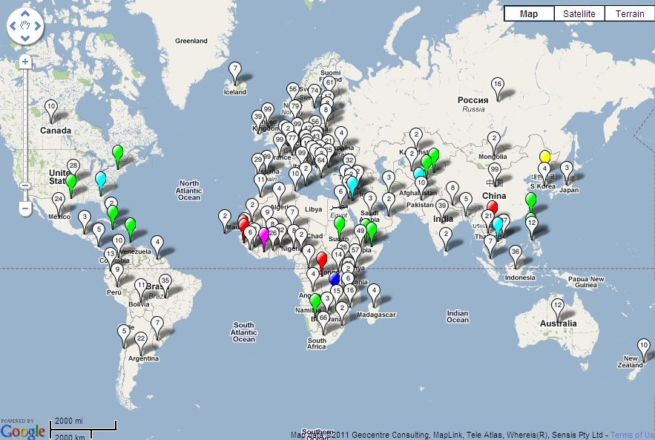
International orientation
Notes:
20/09/2014
10

Slide 11
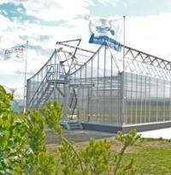
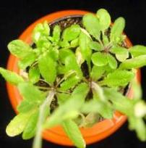
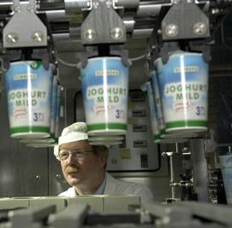
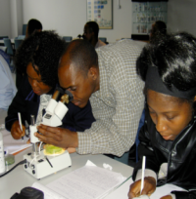
The Wageningen Approach
...Science with impact...
Leap
Technological
Socio-economic
Incremental
Leap

Slide 12
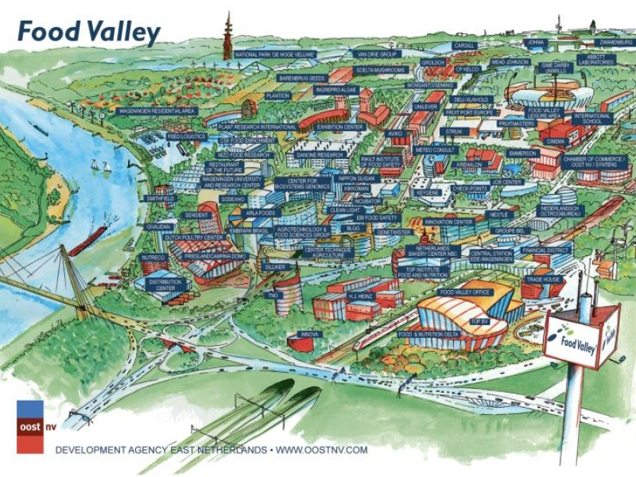
Embedded in Food Valley
...Science with impact...
A great network
Close collaboration:
  Business
  Education & research
  Government
  Partnerships
Aiming at innovation
Facility sharing
Notes:
The region around Wageningen is home to a concentration of research institutes and companies with a focus on nutrition and food production. They come together in the "Food Valley Foundation," which supports and facilitates meetings and cooperation. Partnerships between members and sharing facilities is part of what can speed up innovation. Wageningen UR is a key player within the food valley network.

Slide 13

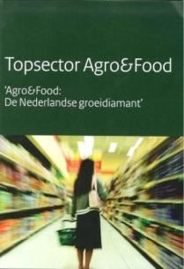

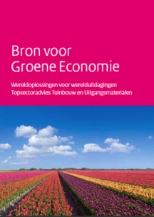

The Golden Triangle
Entrepreneurs
Society
Government
Science

Slide 14
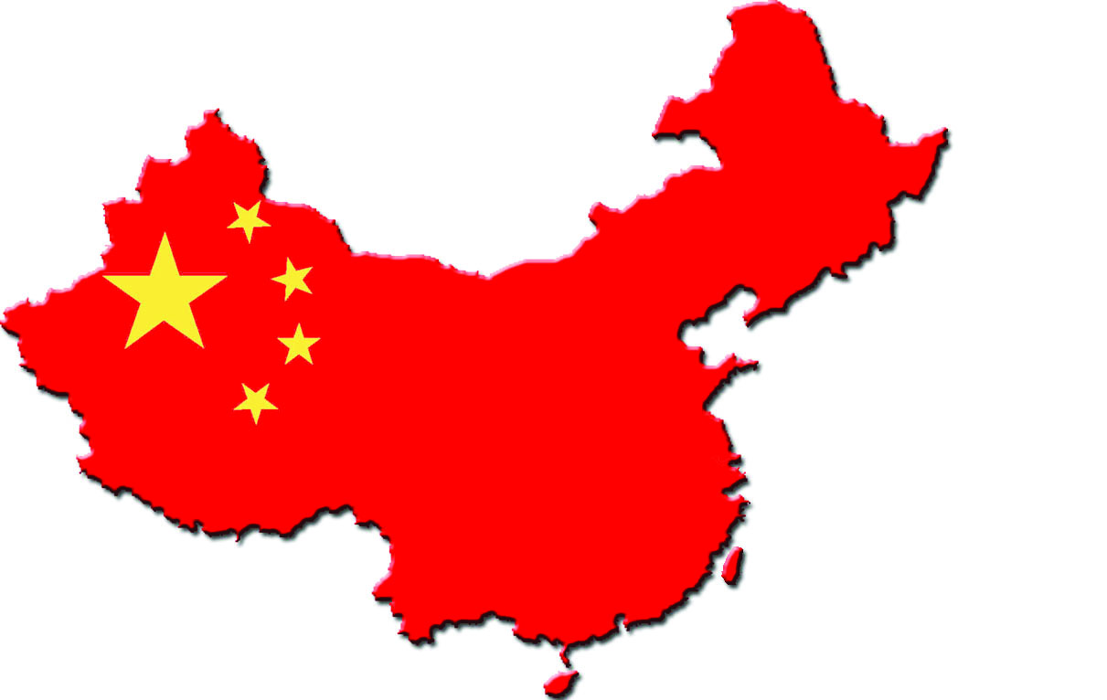
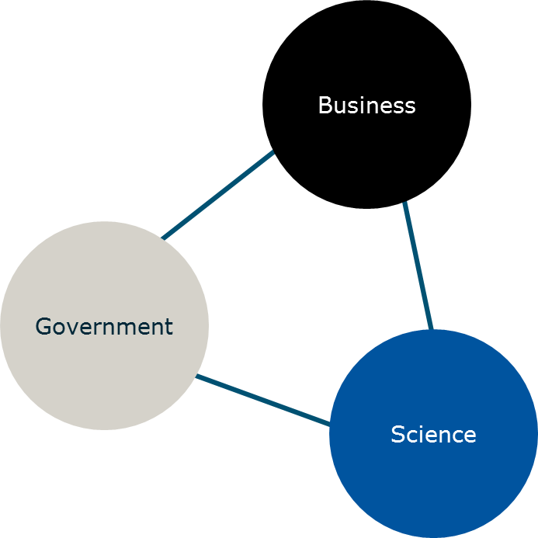
International collaboration
B to B
G to G
S to S

Slide 15
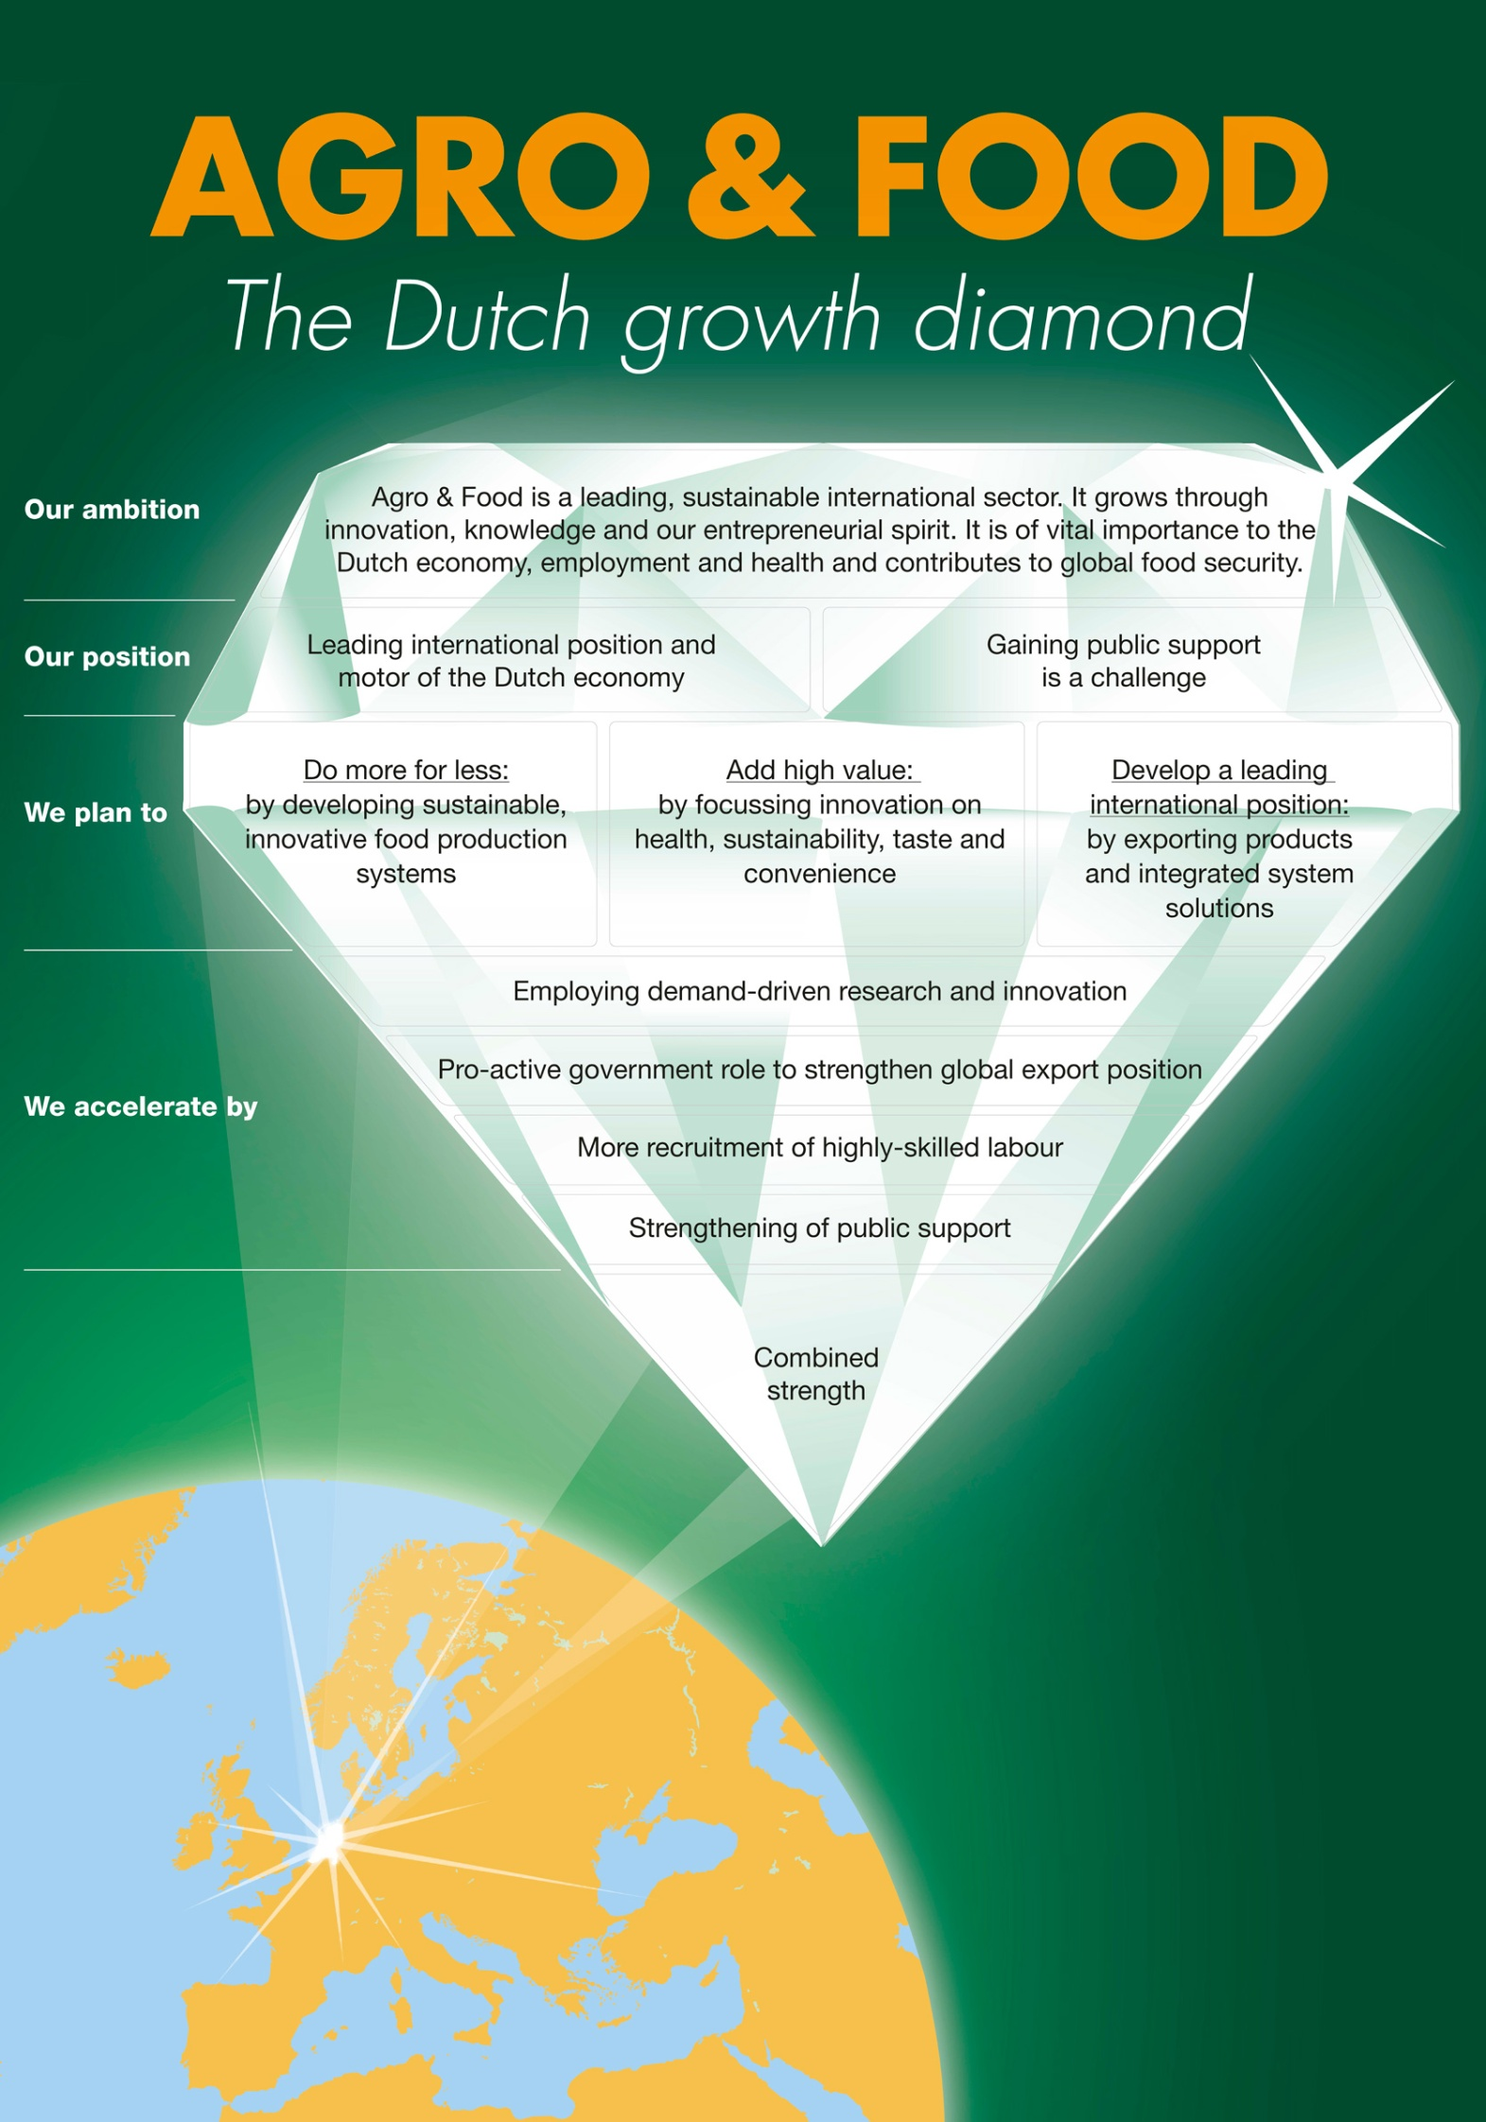
Top sector

Slide 16
Position of Top sector Agri & Food:
12 of world’s top 40 Food & Beverage businesses have large branches or R&D departments in the Netherlands
World top 40 Food & Beverage businesses (Turnover 2010 in € millions)
Nestlé
Diageo
Cargill¹
AMBEV
Archer Daniels Midland Company
Nedalco takeover can strengthen Cargill in the Netherlands
SABMiller
Unilever
Fomento Económico Mexicano
Pepsico
BRF – Brasil Foods
New European head office in the Netherlands
Kraft Foods
ConAgra Foods
Anheuser-Busch InBev
Fonterra Co-Operative Group
The Coca-Cola Company
Ajinomoto Co.
JBS
Kellogg Company
Will become German
Wilmar
Dean Foods
Tyson Foods
After Numico takeover policy centre for health and baby food remains in the Netherlands. Strengthening of R&D located in Utrecht
Vion²
Kirin Holdings Company
Koninklijke FrieslandCampina
CHS
Meiji Holdings
Sara Lee
Research centre in Nijmegen
Mars¹
Yamazaki Baking
Danone
Smithfield Foods
Heineken
Land O Lakes
Asahi Breweries
Suntory¹
Associated British Foods
Carlsberg
General Mills
HJ Heinz
0
50,000
100,000
0
50,000
100,000
Dutch company
Company with important business location or R&D in the Netherlands
Recent developments
Participates in TIFN
Notes:
16

Slide 17
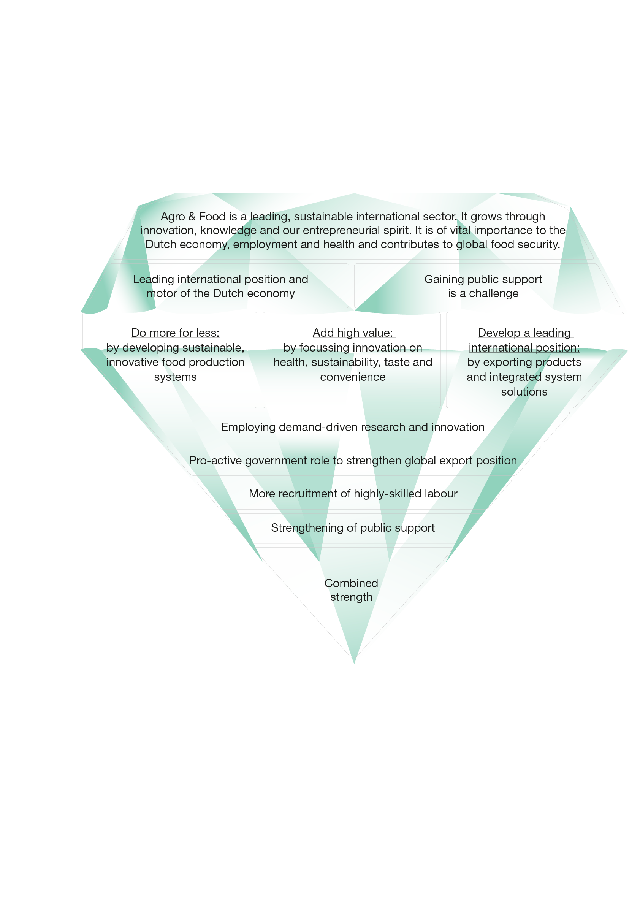
Three opportunities
Notes:
Agro & Food is a leading, sustainable international sector. It grows through innovation, knowledge and our entrepreneurial spirit. It is of vital importance to the Dutch economy, employment and health and contributes to the global food security.
Leading international position and motor of the Dutch economy.
Public support is a challenge.
more for less: by developing sustainable, innovative food production systems
high added value: by focussing innovation on health, sustainability, taste and convenience
leading international position: by exporting products and integrated system solutions
demand-driven research and innovation
pro-active government role to strengthen global export position
more recruitment of highly-skilled labour
strengthening of public support
Combined strength

Slide 18

Do more with less: develop sustainable, innovative food production systems; sustainability across the whole Agri&Food chain
Primary production in NL
Processing Industry
Distribution
Retail / Hotel & catering
Water usage
Energy usage
CO₂ reduction
Waste flows
Packaging
Ecosystem /
Recycling
Animal Welfare
Sustainable imports
Theme relevant to section of the chain
Notes:
18

Slide 19
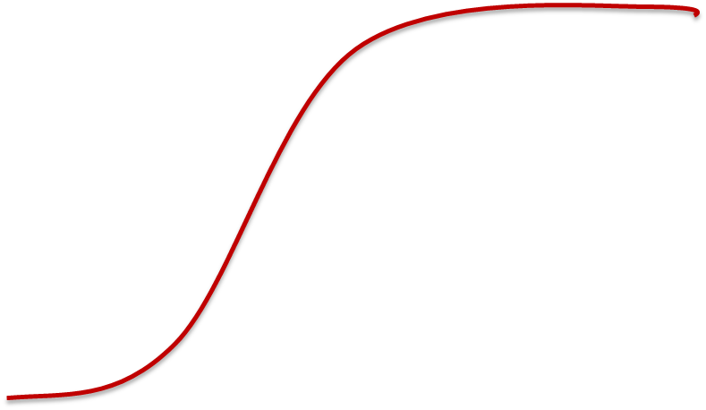
More with less: Sustainable Intensification
Intensification
‘Ecologisation’
Context
Attainable productivity
Context
Poverty traps
Eco-efficiency possible
Inefficiency and pollution
Resources/ investment
Towards an ecological intensification of world agriculture - Tittonell (2013)

Slide 20
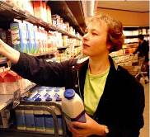
Greater added value:
focus innovation on health, sustainability, taste and
convenience
The consumer wants...
Primary
production
Processing
Distribution
Retail/Hotel & catering
Examples of value creation across the chain
Improved/more healthy crops
Functional ingredients, less salt and saturated fats
Hygienic distribution of fresh products
Healthy preparation methods
1
Healthy food
No animal suffering
Optimisation of raw material use
Minimisation of CO2 emissions
Sustainable packaging, sustainable cooling
2
Sustainable food
Breeding for taste
Optimal processing to retain aroma and flavour
Packaging to retain maximum quality
Improved preparation methods
3
Tasty food
Production of long-life products
Ready sliced products
Regular delivery
Improved portion size for ease of use
4
Convenient food

Slide 21
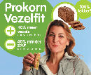
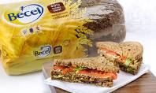
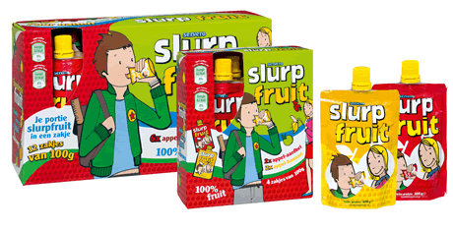
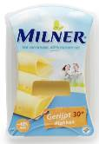
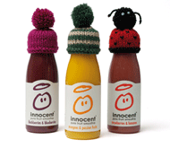
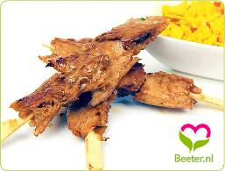
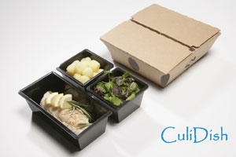
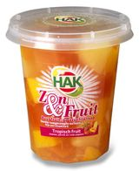
Greater added value: innovation focussed on health, sustainability, taste and convenience

Slide 22

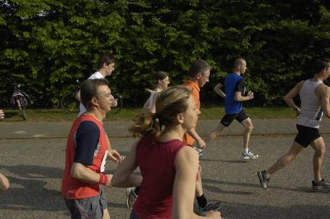
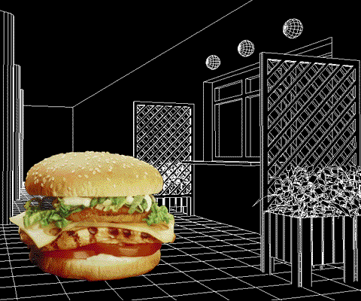
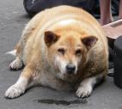
Health and lifestyle

Slide 23
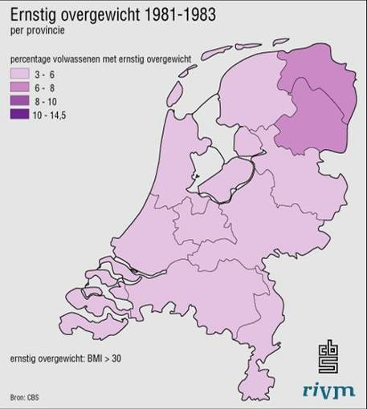
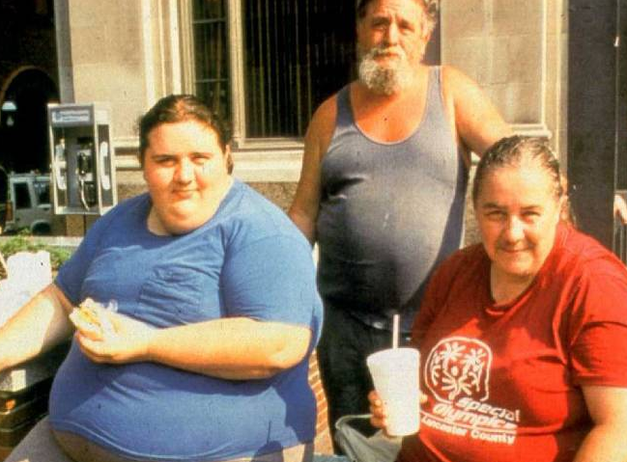
Need for PPP: Food choice and Lifestyle

Slide 24

Need for PPP: Food choice and Lifestyle

Slide 25
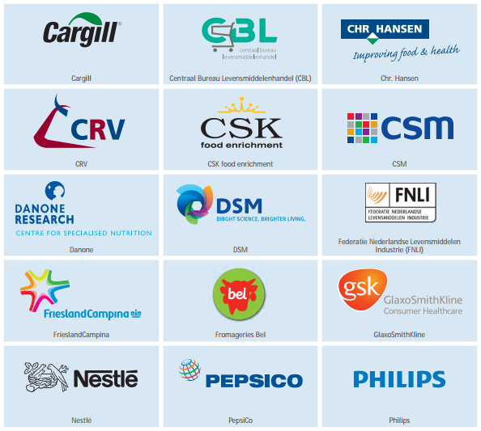
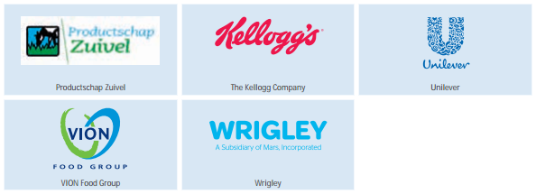
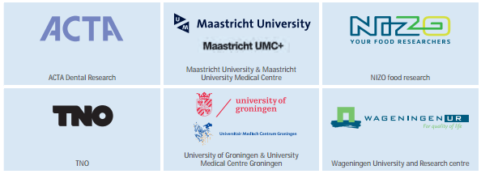
Example of a successful public-private partnership in the Golden Triangle: Top Institute Food & Nutrition
Partners
  Excellent knowledge, >1000 publications in peer-reviewed journals (1998-2011)
  Citation impact 2x higher than world average
  Yearly turnover programme € 20 million. Further growth into EU topinstitute
  5 new international top businesses
  Application of knowledge in new products with national turnover of € 710 million

Slide 26
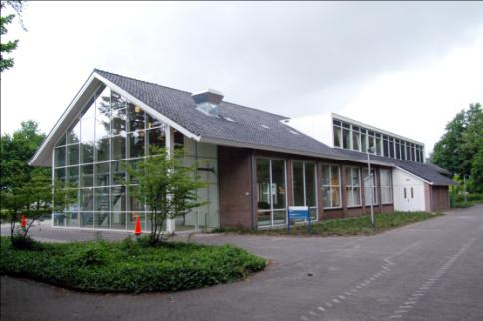


Restaurant of the future
A normal university
restaurant
Look inside…
Diners being observed

Slide 27






Other examples of PPPs:
Sustainable Dairy Chain
World leader in genetics
Algae Food & Fuel designs and builds for the industrial and agricultural production of algae: algae farming.
Airline In-flight Industry

Slide 28






Examples of PPP results:
Food processing R&D
Ohmic heating
High pressure sterilisation
Microwave heating
High speed product sorting

Slide 29


Chain Management PPP:
Extending fresh borders
Modality shift:
From airplane to
container ship

Slide 30
Food waste: solutions? Need for PPPs
Roughly 1/3 of food produced for human consumption is lost or wasted globally. Which amounts to about 1.3 billion tons per year (FAO, 2011)
the Netherlands total shrinkage in the food chain values 4.4 billion €

Slide 31




Golden Triangle in China
Sino-Dutch Dairy Development Centre
  Improve the dairy safety and quality in China
  Implement the golden triangle model
  Initiate joint research and education activities
Yili on Wageningen Campus

Slide 32
Unique solution: Food security through an integrated approach
Safe food production system with COFCO
Beijing Eco-Valley project
Challenge
Problem
  How to secure effective and safe food production and distribution in metropolitan areas i.e. Beijing
Solution
  Combine Wageningen UR disciplines to come to one integrated advise
  Food Park for sustainable, effective use of resources combined to safely provide food
Result
  Blueprint for a Beijing food park respecting local constraints
  Sustainable food production close to metropolitan areas to adapt to urbanization
Notes:
Information on this project
For more information:
***@wur.nl

Slide 33



謝謝!
…To explore the potential of nature,
to improve the quality of life…

