Slide 1


Philippe CHOQUET
President LASALLE Beauvais
ENTREPRENEURSHIP
Structuring mission for universities of agriculture.

Slide 2
Universities of Agriculture and L. Sciences
Key challenges
Key challenges in agriculture and rural aras
  Food security / Food safety / Human health
  Environmental concerns / Climate change
  Rural exodus
  Human skills scarcity in agriculture
On-going revolution in Higher education
  Competitive context / Globalization
  Budget constraints
  M.O.O.C.s impact (Knowledge transmission? Competences? )
COMMITMENT
UNCERTAINTY
AGILITY

Slide 3
Universities of Agriculture and L. Sciences
Entrepreneurship: a core competence
Whatever is the context / constituency / job
Entrepreneurship is a K.F.S.
Key Factor to SURVIVE
for SUSTAINABILITY
of SUCCESS
It has to be a backbone of the EDUCATIVE PROCESS
How to transmit it ? How to live it ?

Slide 4
Case study
Institut Polytechnique
LASALLE Beauvais

Slide 5
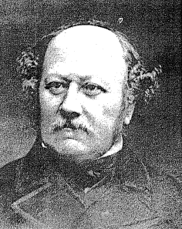
I.P. LASALLE Beauvais
Inspiring history
LA SALLE Beauvais since 1854
« To educate leaders in agriculture
in order to fight poverty in rural areas »
A global committment of the LASALLE network

Slide 6
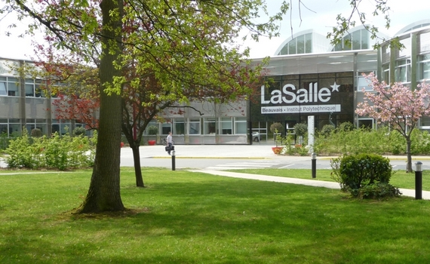
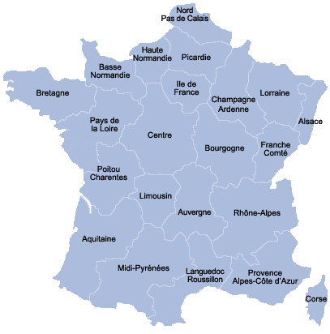

Beauvais – 1 h. to the Eiffel tower

Slide 7
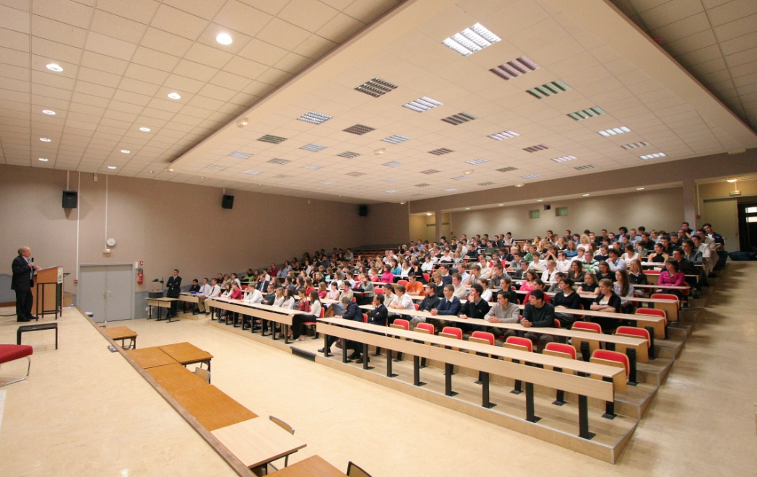
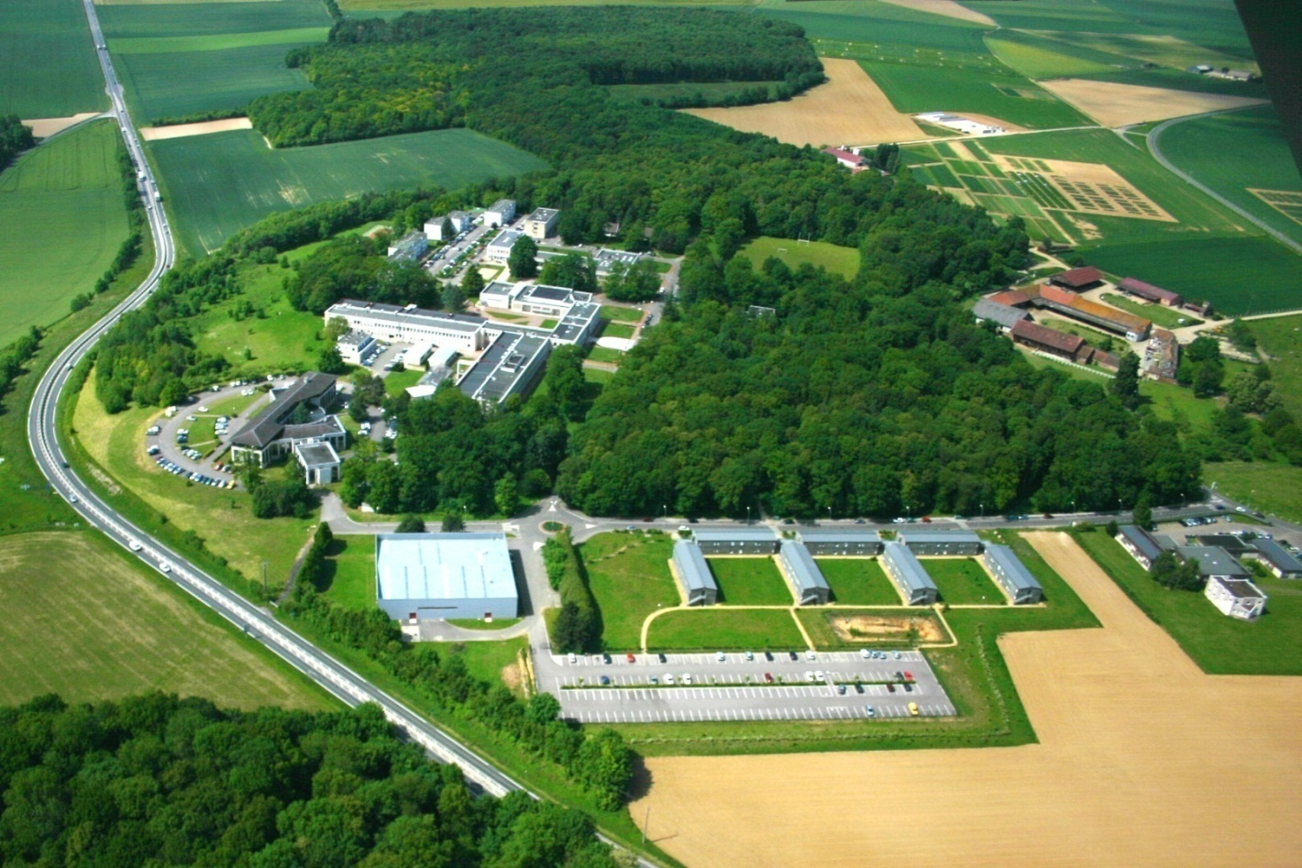
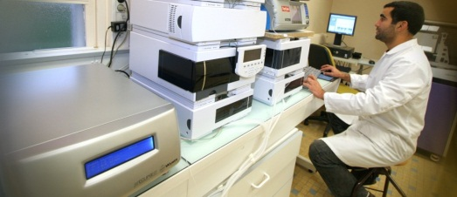
A Grande Ecole
3 main fields (Research + Programs)
Agriculture
-
850 students
Nutrition
& Health
-
460 studentss
Geology
-
450 students
  CAMPUS ORGANISATION
  1 100 dorms
Intellectual Capital
Integral Education
Human Capital
Notes:
Recrutement post-bac sélectif (85% de mention), une insertion professionnelle performante (85 % d’élèves en poste moins de 4 months après leur sortie d’Ecole)

Slide 8
Case study
I.E.S. project

Slide 9
I.E.S. Project
Innovation – Entrepreneurship - Service
  INNOVATION
  ENTREPRENEURSHIP
  SERVICE
An on going project at LASALLE

Slide 10
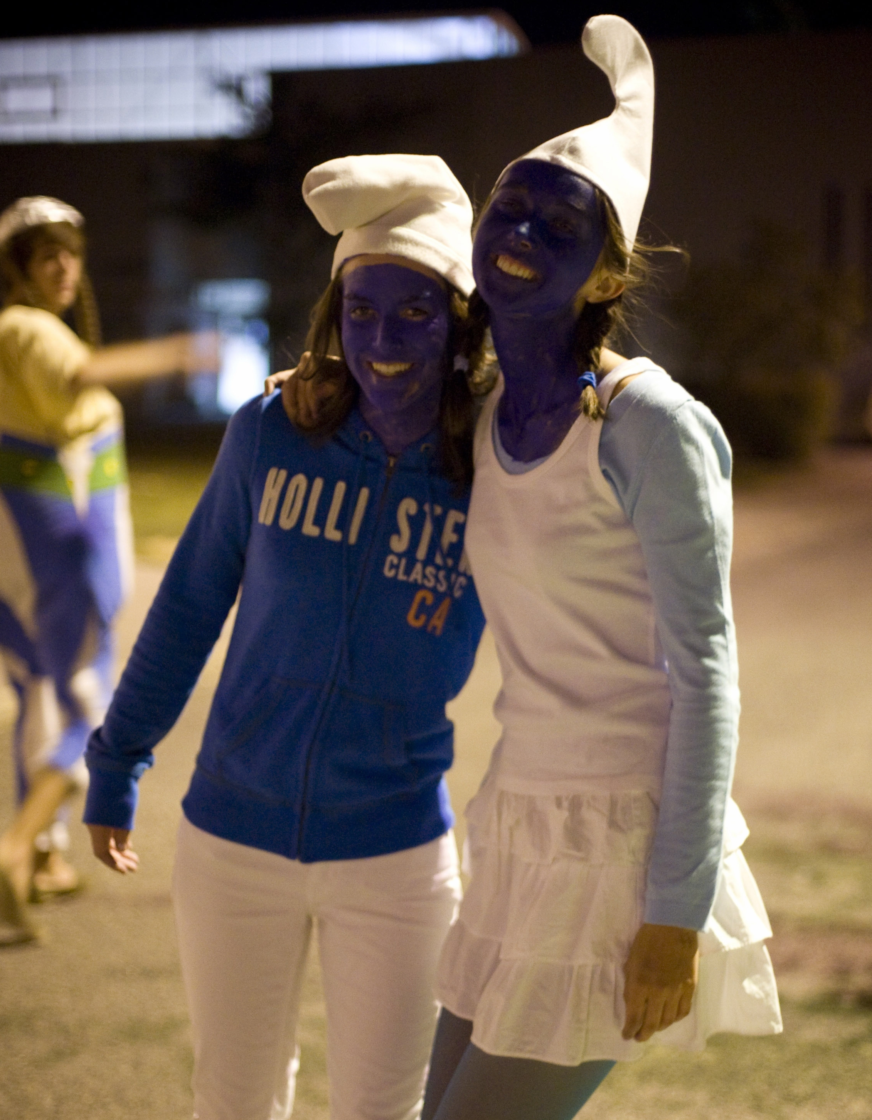
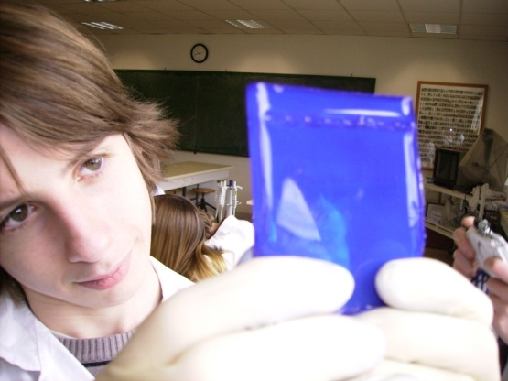
I.E.S. Project
Innovation
  Academic
    Interdisciplinarity Sciences/ Techno / Humanities
    (innovation ⬄ social need)
    Research oriented programs
    Profiles of students / profesors
    Internationalization
  Students life
    Promote activities that can develop creativity / curiosity
    Initiatives for new activities
  Exemplarity
    Attitude towards creativity / diversity
    Communication on research activties
    universities innovation

Slide 11
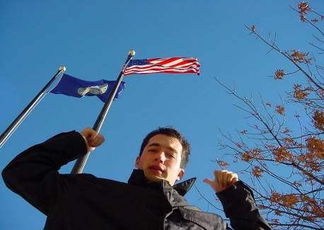
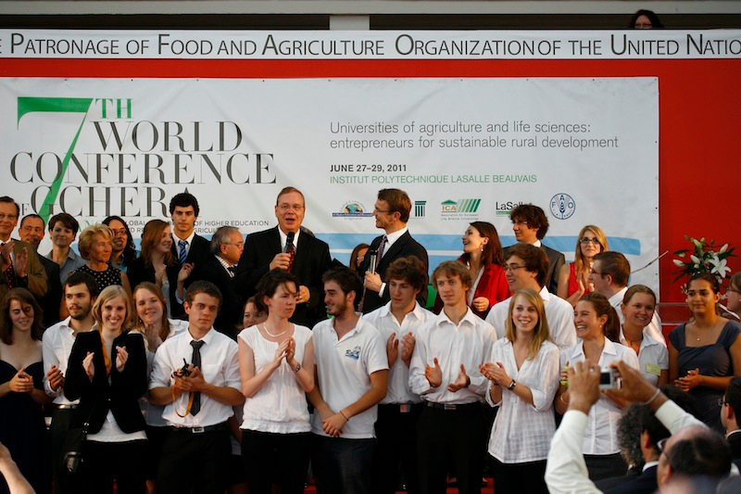
I.E.S. Project
Entrepreneurship
  Academic
    Mapping of courses to ensure that ALL studenst have basic skilsl for entrepreneurship
    Project pedagogy
    Profiles of students / profesors
  Students life
    Promote activities that develop
      Commitment
      Sense of responsability
      Enable to experience RISK
      Sales experience
    => Take advantage of Student Life + Associations
  Exemplarity
St

Slide 12
I.E.S. Project
Service
    SERVICE ⬄ SOCIAL RESPONSABILITY
  Students life
    Get students to experience social reponsability
    Committment of Service and Solidarity
    - 20 hours/year/student = 34 000 hrs./year
    Associative/charity commitment
  Exemplarity
    Commitment / Communication
    Ex.: Handicap program, Culinary program against precarirty etc.
,

Slide 13

I.E.S. Project
A global attitude
    It is often easier to say NO than YES
    Between 18 and 25 years, young people are enthousiastic
    And eager to be entrepreneurs
    EDUCATE = REVEAL
  Positive attitude to develop self confidence
  Encouraging attitude to take (calculated) risk
  Enable experiences of fails + revisit experiment
  Celebrate success
,

Slide 14

Case study
ISAGRI
A success story

Slide 15

A pioneer company in software for agriculture
Setting up
Jean-Marie SAVALLE
Prof. at ISAB/LASALLE
3 employees
1st subsidiary
in
Spain
1st website
fully dedicated to
agriculture
terre-net.fr
1983
1991
1997
ISAB/LASALLE main stockholder
Sale of shares

Slide 16
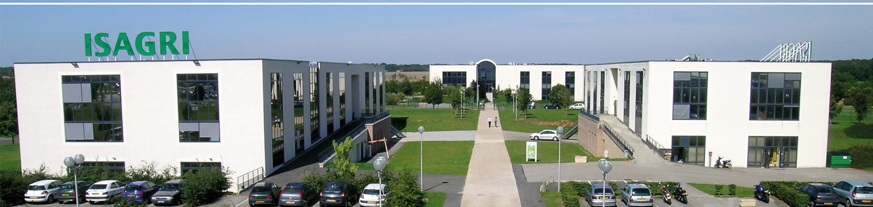

A leading group
Diversification towards
Accounting co.
Mergers/acquisitions
Acquisition of the N°1 Press group
in Agriculture
France Agricole
2001-2002
2006-2010
2011
5 companies absorbed

Slide 17
Groupe ISAGRI
Chiffres clés
1400 salariés
122 M€ de CA Services
110 000 clients logiciels
8 filiales en Europe + Canada
200 000 abonnés et lecteurs media

Slide 18
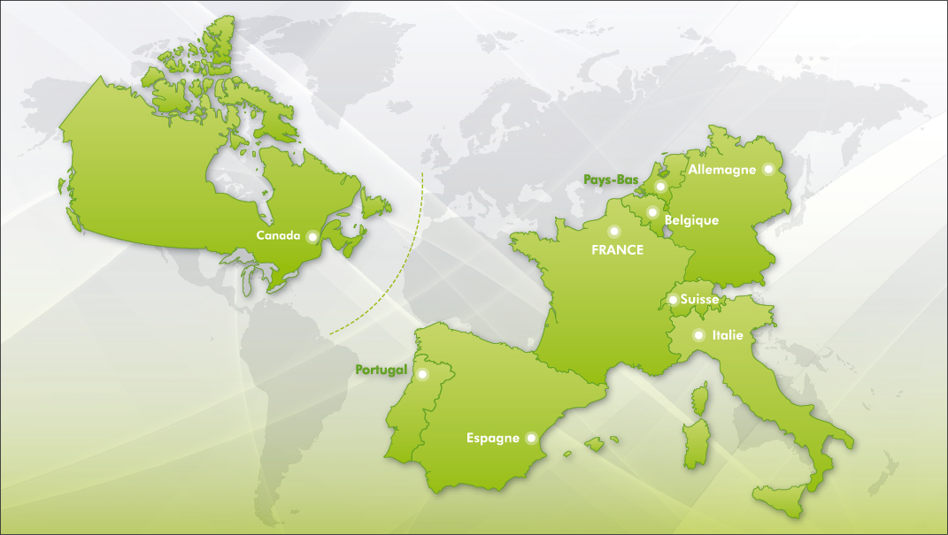
ISAGRI a global leadership
Connections with universities

Slide 19


ISAGRI in China
A subsidiary with 3 employees in China
A software specialised in Pork production
Based on a recognised know-how in Europe
For more information
www.isagri.com

Slide 20
ENTREPRENEURSHIP
A GLOBAL ATTITUDE
TO BE TAUGHT
CONCLUSION
TO BE ADOPTED

Slide 21

Thank you for your attention
Notes:
Penser à modifier les dates pour les JPO.

