Slide 1
Potential for Universities to be partners in Agricultural Development Enterprises in Emerging Economies
Trevor Tomkins Ph.D.
Founder and President venture | dairy
GCHERA World Dialogue Education and Innovation in Agriculture and Life Sciences
Nanjing September 2014

Slide 2
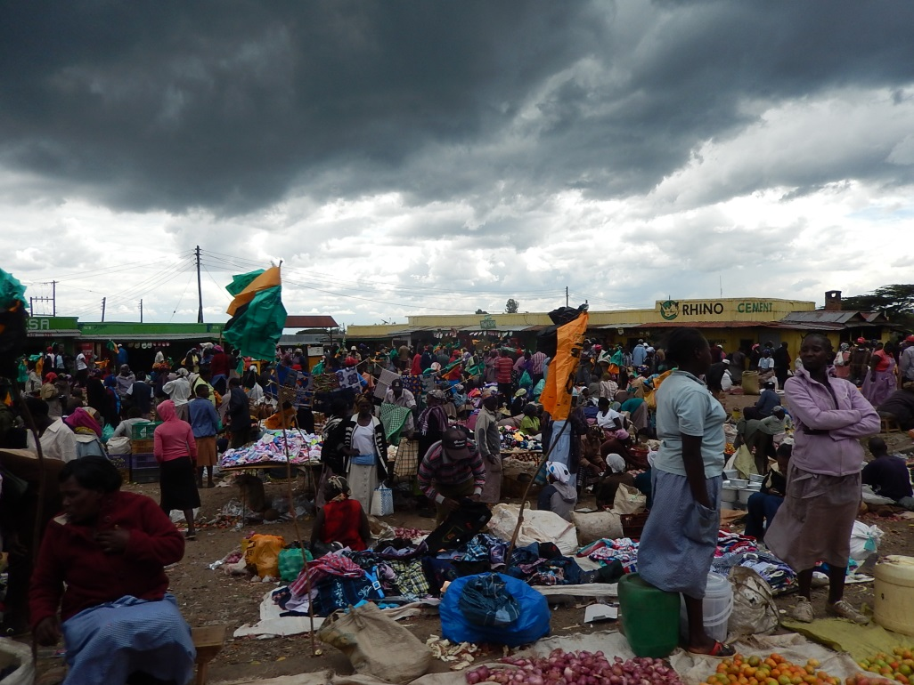
Contents
Context
  Global Food Security
  Failure of Development to
  date
  Understanding value chains
  Drivers
Opportunity
  How do we make change?
  Multi disciplinary approach
  Need for talents

Slide 3
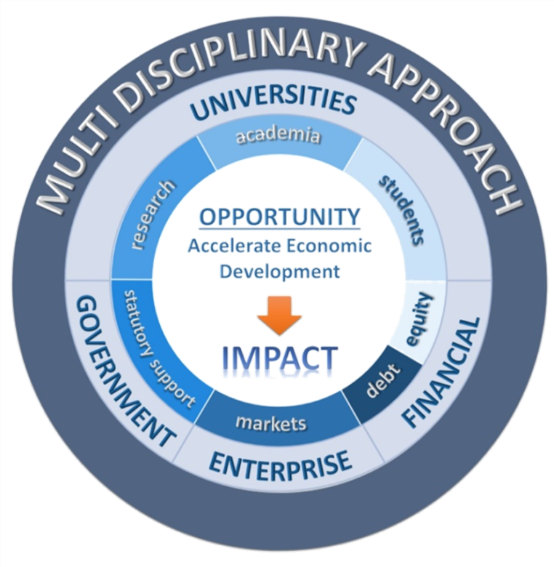
Contents (cont’d)
Specific Potential for Universities
  Curricula
  Research
  Academia
  Students
Critical Success Factors

Slide 4
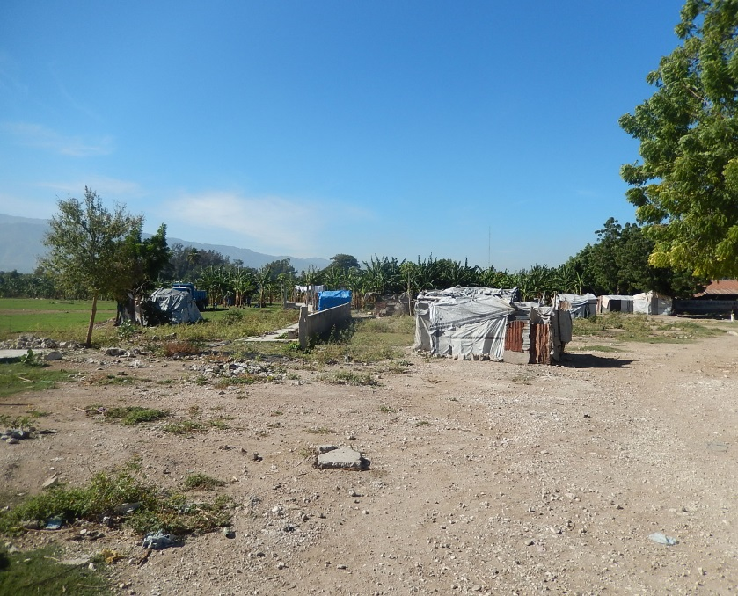
Context
Global Agricultural Issues = CRISIS
  Growing world population
  Increasing standards of living
  More high quality food-food safety
  Less Land and less water
  Aging farming population
  Inefficient practices
  Sustainability-people, planet, prosperity
  Climate change
  Food wastage
  Failure of aid based development

Slide 5
Context: Understanding where we are
QUESTION: Why not more progress?
Complex issues-many interactions
Failure of international aid agencies and NGOs
Silo approach to dealing with issues
High risk ‘investment’ considerations
Lack of qualified people
Governments with different priorities
Lack of access to capital, appropriate technology
ANSWER: Need highly educated people prepared to understand the issues and resolve them with a multi disciplinary approach

Slide 6
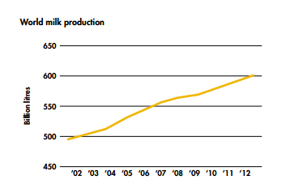
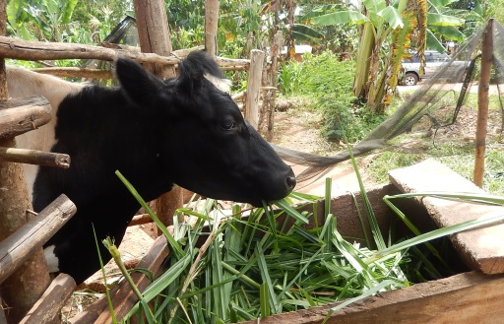
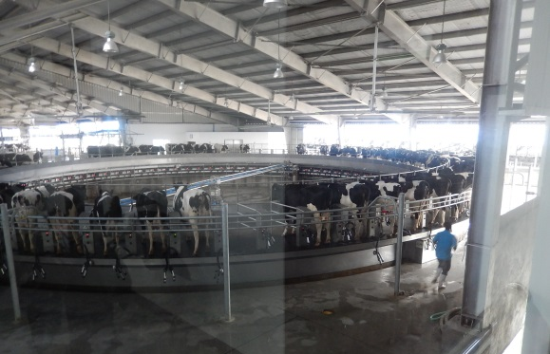
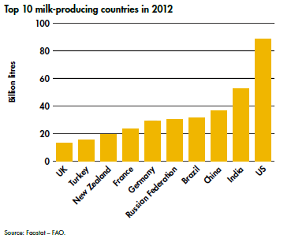
Dairy Industry as a Case Study
Dairy production is one of the major agricultural businesses

Slide 7
Dairy Industry as a Case Study
Cattle are the backbone of rural communities in developing countries
Cattle account for perhaps 50% of ‘employment’ in developing countries
The statistics are grim:
  Cows produce <3 liters of milk a day (Best ww >30)
  Convert feed to milk at <1 kg milk per kg of feed (Best >1.7)
Opportunity to radically change rural prosperity and food security if huge

Slide 8
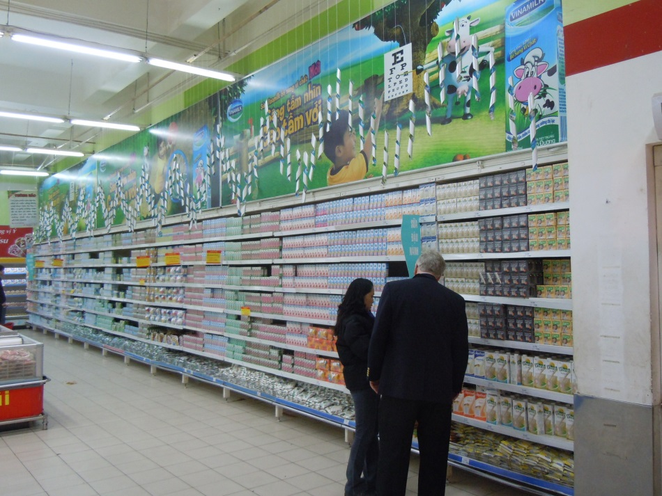
Drivers of Progress and Innovation
Markets
  Development must be PULL not PUSH
  Speak with data
  Marketing recognized as a discipline
Capital
  Access is fundamental
Technology
  Access to appropriate technology
Public Private Partnerships= Policy initiatives
  Government, industry, universities
  Must have an educated work force equipped to understand the issues

Slide 9
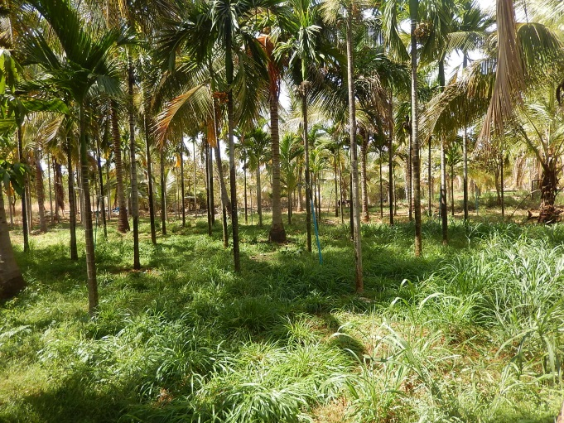
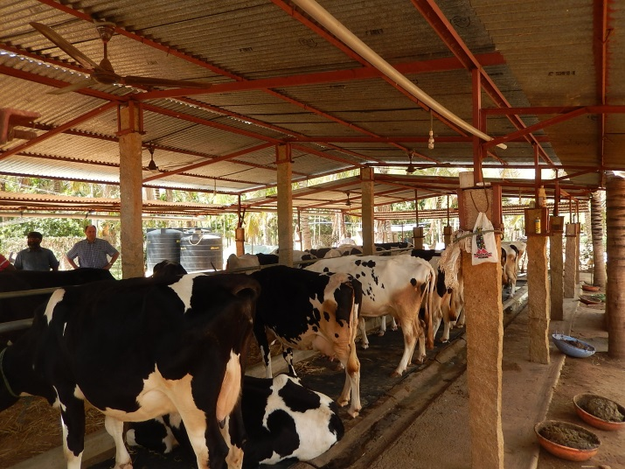
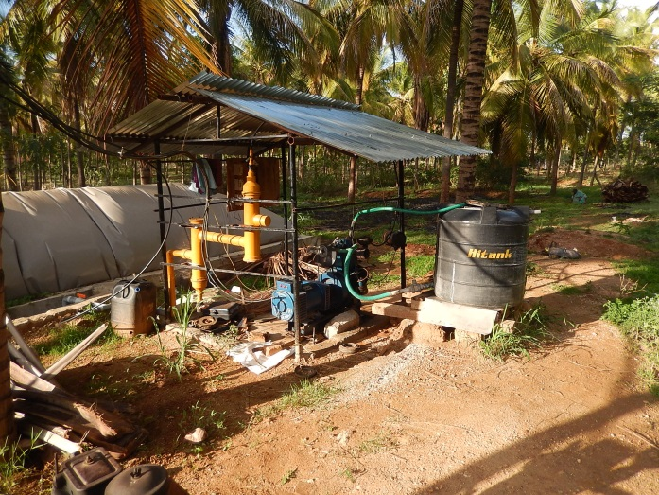
Developing a multi-disciplinary approach
Need to move to a concept of integrated food production
Fundamentals are:
  Energy
  Water
  Soil
  Fertilizer
  Appropriate species

Slide 10
venture | dairy-shared value chain
‘Pull’ versus ‘Push’
Farmer focused processing
Farmer and Employee Ownership
$$$
Branded
Consumer Products
$$$
For Profit Enterprises
$$
Marketing/Sales/
Distribution
Liquid milk
Fortified milk
Flavored Milk
Milk powder
Butter/ghee
Paneer
Yogurt
Cheese
Ice Cream
Whey
UHT/ESL/Pasteurized/raw
Research and Development
Product innovation
Point of sale packaging
Distribution methods
Processing
$
Dairy Hubs
Anchor
Processing
Leveraging : Non-Profit /
Government Support
Servicing Multi Villages
Collection
Transportation Solutions
Chilling
Quality Laboratory and testing
Digital payment to producers
Hygiene control
Technical support
Capital lntensive
Pull Through for Supply Chain
Services Multiple Dairy Hubs
Services Multiple collection Centers
Packaging
Formulation innovation
Products deeper into economic pyramid
Dairy Hub
Feed/Feed analysis
Premixes/concentrates
Veterinary/Supplies
Quality Laboratory and support
Micro loans
Services, AI
Production
Platform Farm(s)
Extension Services
Cooperative Support
Technical Assistance
Supply Contracts
Capacity
Building
Fair Price
FARMS
FEED/SERVICES
COLLECTION
PROCESSING
MARKETS

Slide 11
venture | dairy - development through enterprise impact model – “pull not push”
Sector Specific – Dairy
Entrepreneurial
empowerment
Commercial returns
for investors
Scalable Enterprises
Anchor processing
firm-based projects
Profit Motivation
Filling a missing link –
milk processing
Value chain enhancement
Increased opportunities
for women
Accelerating
Economic Development
Business skills
Developing Economies with High GDP
Technology
Improved food
security
Job creation
Social Impact
Operational
Expertise
Management
systems
Smallholder
farmer benefits
Finance
Improved nutrition
Dairy know-how
Positive environmental impact
--Climate change
--Water sparing
--Waste reduction
Technical Expertise Networks
Strategic Project Partners
Replicable Platform

Slide 12
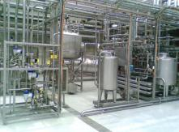
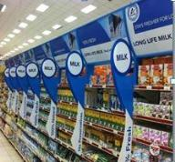
dairy hub concept
GENETICS
VETERINARY SERVICES
RECORD KEEPING
ARTIFICIAL INSEMINATION
MILK
PROCESSOR
MILK COLLECTION-QUALITY
FORAGE PRESERVATION
ANIMAL HEALTH
FEED NUTRITION
MARKET
SMALL HOLDER FARMERS
SATELLITE HUBS

Slide 13
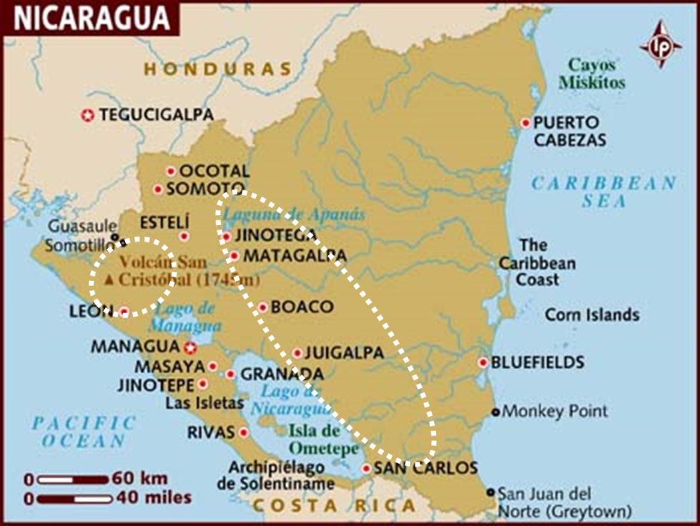
Nicaragua: Cattle Hub

Slide 14
Nicaragua: Cattle Hub
Year doing research. Why had previous initiatives failed?
What could we do differently?
Market: linked with a milk processor
Linked with a cooperative supplying the processor
Hired very strong leader-M.Sc. From Honduras
Set up platform farms
Developed a ‘show you’ not ‘tell you’ program on farms
Someone had to pay

Slide 15
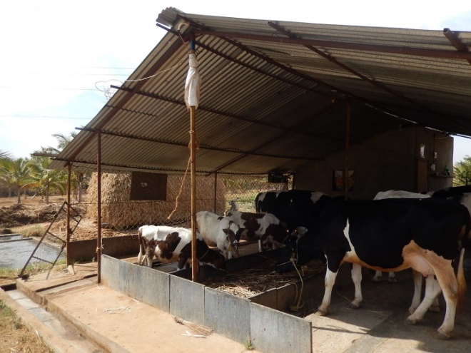
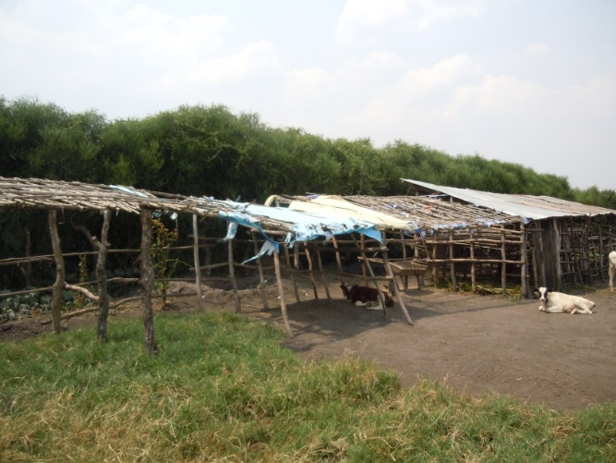
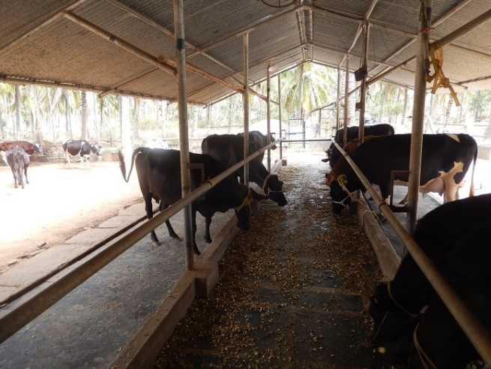
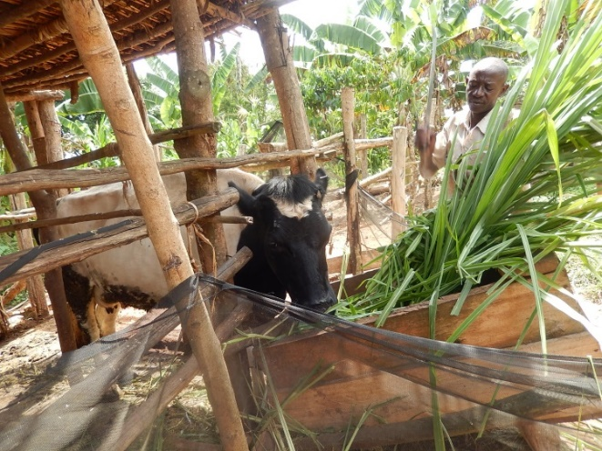
Economic farming units

Slide 16
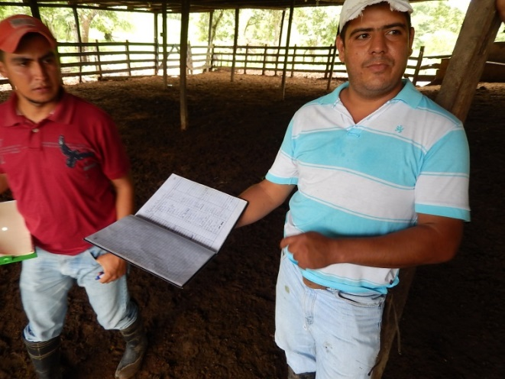
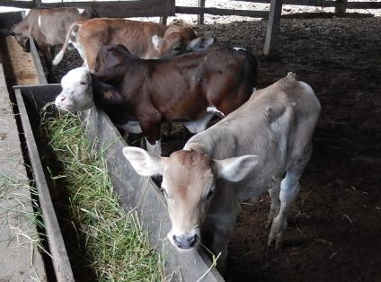
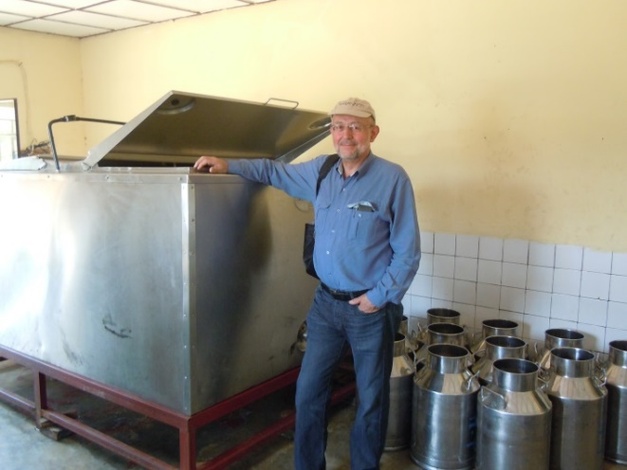
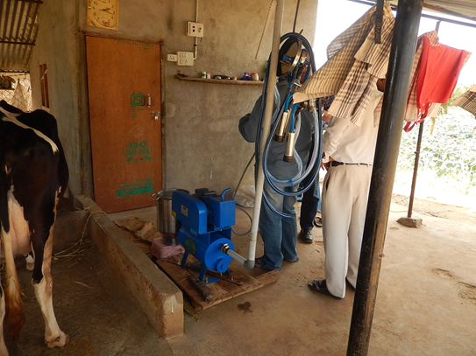
Best production practices

Slide 17
Nicaragua: Cattle Hub
Difference in milk production and conception rate,
by type of farm in San Felipe, Boaco
Type of Farm | Milk Production |  | Conception Rate %
 | Kg/cow/day | Kg/farm/day
With Cattle Hub | 5.0 | 140.0 | 51.7
Without Cattle Hub | 3.1 | 63.0 | 40.4

Slide 18
Nicaragua: Cattle Hub
Difference in daily weight gain and live weight at 12 months
in calves grown under different type of management.
Type of Farm | Daily weight gain (g/day) |  | Live weight at 12 months (kg)
 | Traditional | Early weaned
With Cattle Hub | - | 371.1 | 240.0
Without Cattle Hub | 116.1 | - | 107.0
Difference in stocking rate and milk production per hectare,
by type of farm in San Felipe, Boaco.
Type of Farm | Stocking rate (heads/ha) | Difference % | Milk Production (kg/day/ha) | Difference %
With Cattle Hub | 2.33 | 106 | 11.65 | 233
Without Cattle Hub | 1.13 | - | 3.50 | -

Slide 19
Nicaragua: Cattle Hub
Estimated contribution to the local economy (transfer price)
at each step of the value chain.
 | Farm | Collectionª | Processor^{b} | Retail^{c}
Price paid, USD/L | 0.35 | 0.08 | 0.80 | 0.94
Cost to produce, USD/L | 0.19 | 0.05 | 0.64 | 0.80
Contribution | 0.16 | 0.03 | 0.16 | 0.14
Total contribution, USD/L |  |  |  | 0.49

Slide 20
Nicaragua: Cattle Hub
Annual cost for technical assistance in COOPA, Acoyapa.
Description | Unit | Amount | Cost/Unit (US$) | Total (US$)
Labor |  |  |  | 15,200
Technician | Salary | 13 | 800 | 10,400
Travel expenses | Monthly | 12 | 400 | 4,800
Training |  |  |  | 6,900
Conferences | - | 5 | 900 | 4,500
Field schools | - | 6 | 400 | 2,400
Project administration |  |  |  | 25,000
TOTAL (US$/YEAR) |  |  |  | 47,100
Payment of the technical services in COOPA, Acoyapa.
Description | Payment, US $
 | Monthly | Annual
Farmers (35 x US $50.00) | 1,750 | 21,000
COOPA | 575 | 6,900
Centrolac, S.A. | 1,825 | 21,900
TOTAL | 4,150 | 49,800

Slide 21
Nicaragua: Cattle Hub
Predicted improvements in milk yield (1,000 L) produced on farms that the Cattle Hub works with over five years and resulting contribution (USD 1,000)
to the local economy at each step of the value chain.
 | Year 1 | Year 2 | Year 3 | Year 4 | Year 5 | Total
Incremental milk yield, total L/yrª | 164 | 2,904 | 8,632 | 17,821 | 31,006 | 60,527
Contribution to the value chain, USD/yr^{b}
Farmers | 26 | 465 | 1,381 | 2,851 | 4,961 | 9,684
Collection^{c} | 5 | 87 | 259 | 535 | 930 | 1,816
Processor | 26 | 468 | 1,390 | 2,869 | 4,992 | 9,745
Retail | 23 | 407 | 1,209 | 2,495 | 4,341 | 8,475
Total contribution, USD/yr | 80 | 1,427 | 4,239 | 8,750 | 15,224 | 29,720
Predicted values reflect year-end milk yield for 20; 330; 640; 950; 1,260; and 1,570 farms in year 1 through 5, respectively. Incremental milk yield is the difference between farms that do not work with the Cattle Hub and those that the Cattle Hub works with and these values do not consider production costs or farmer investments toward improvements. Assumed contribution values (USD/L) to each step of the value chain: farmers, 0.16; collection, 0.03; processor, 0.16; and retail, 0.14. Assumes that the Cattle Hub owns and operates milk collection centers until capital expenditures paid back.

Slide 22
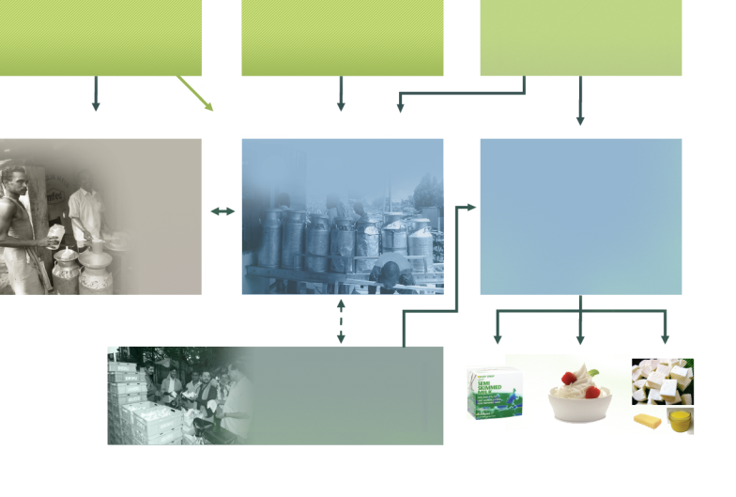
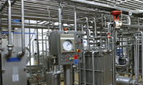
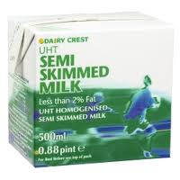




venture | dairy financial model
NGO’s may support
capacity building
(non dilutive)
Non-profit partners
DiDC, Heifer International, others
venture | dairy LLC
investment company
Small holder farmers
Dairy Hubs provide
services & products.
Set up model farms
Processing facilities
make products
Collection centers
sell milk to
established markets
UHT and
non-UHT
products
Yogurts
Butter, cheese,
ghee, paneer

Slide 23
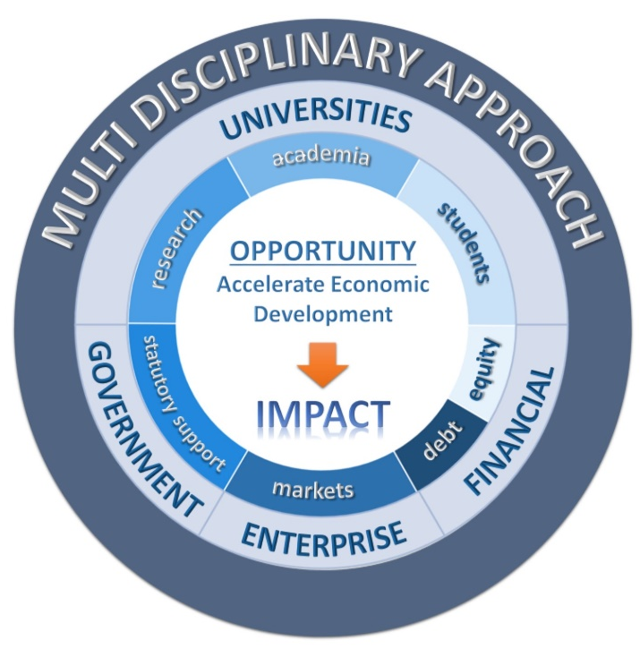
Innovation Networks

Slide 24
Critical Success Factors
Fundamental understanding of value chains
Make decisions based on data
Highly educated professionals who understand the need for a multi disciplinary approach
Do something that brings enjoyment
Pour energy into what is being done

Slide 25

Summary
We can accelerate development and address issues of food security and sustainability by a multi disciplinary approach
Universities must play a lead role in helping this happen
  Academia
  Research
  Students
Understanding the issues

Slide 26
Potential for Universities to be partners in Agricultural Development Enterprises in Emerging Economies
Trevor Tomkins Ph.D.
Founder and President venture | dairy
GCHERA World Dialogue Education and Innovation in Agriculture and Life Sciences
Nanjing September 2014

