Slide 1
Renewable Pathways to Service
Alberta’s Energy Sector
Dr. David Bressler
Professor,
Department of Agricultural, Food & Nutritional Science
Executive Director, BCN
September 21, 2014

Slide 2
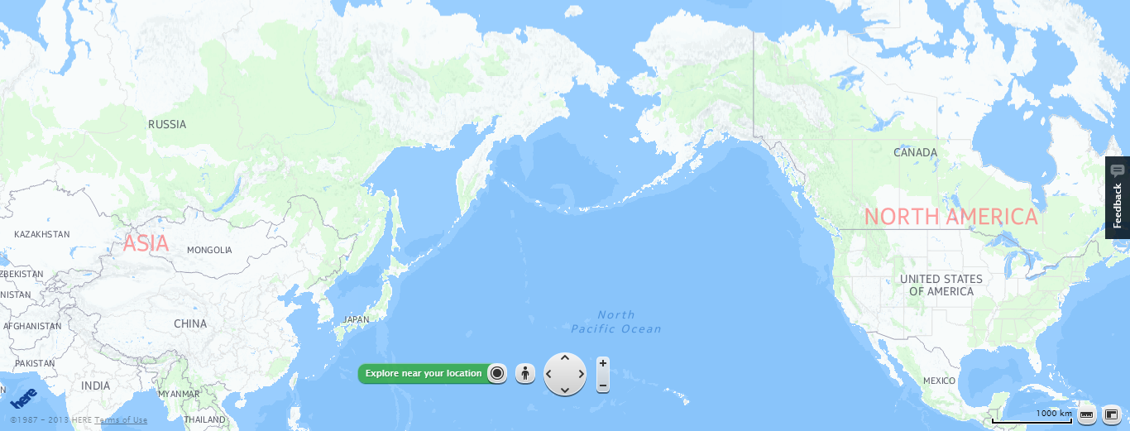
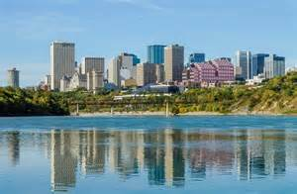

Edmonton
Summer: +30ºC
Winter: -30ºC

Slide 3
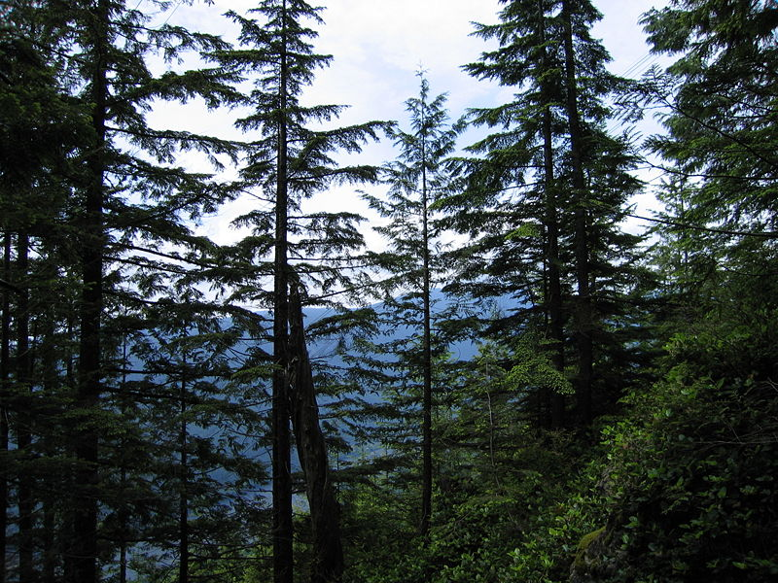
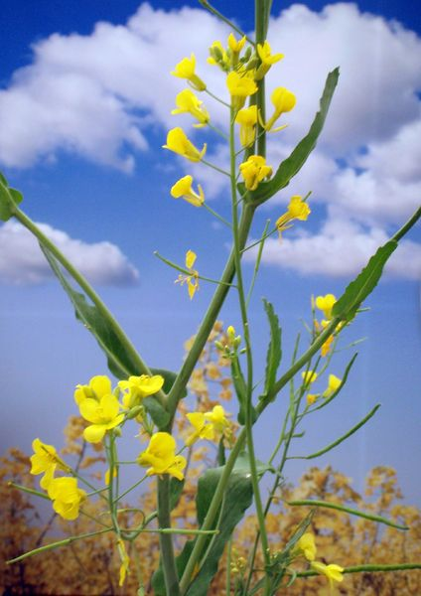
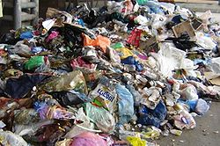
What Is Biomass?
Forestry
Agriculture
Bioindustrial Sector
MSW

Slide 4
Types of Biomass Sources
Total Biomass
Agricultural Biomass
Forest Biomass
Waste Biomass
Whole tree biomass
Municipal waste
(e.g., animal manure)
Grains
(e.g. wheat, barley, canola)
Roadside residues from logging operations
(e.g. limbs, tops branches)
Demolition wood
Straw
(e.g. wheat, barley, oats)
Trees killed by insects
(e.g. mountain pine beetle)
Energy crops
(e.g. miscanthus)
Hybrid species
(e.g. willow, hybrid poplar)
(Kumar, 2013)
Mill residues
(e.g. saw dust, chips)

Slide 5
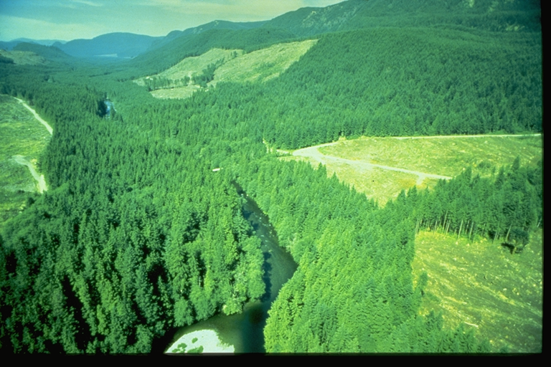
Biomass Opportunity
Alberta Scenario
  Forested Area
  35 million hectares of forest
  Est. annual fibre growth – 45m m³
  Lumber, pulp/paper, panel board
SO: Government of Alberta, SRD
5

Slide 6
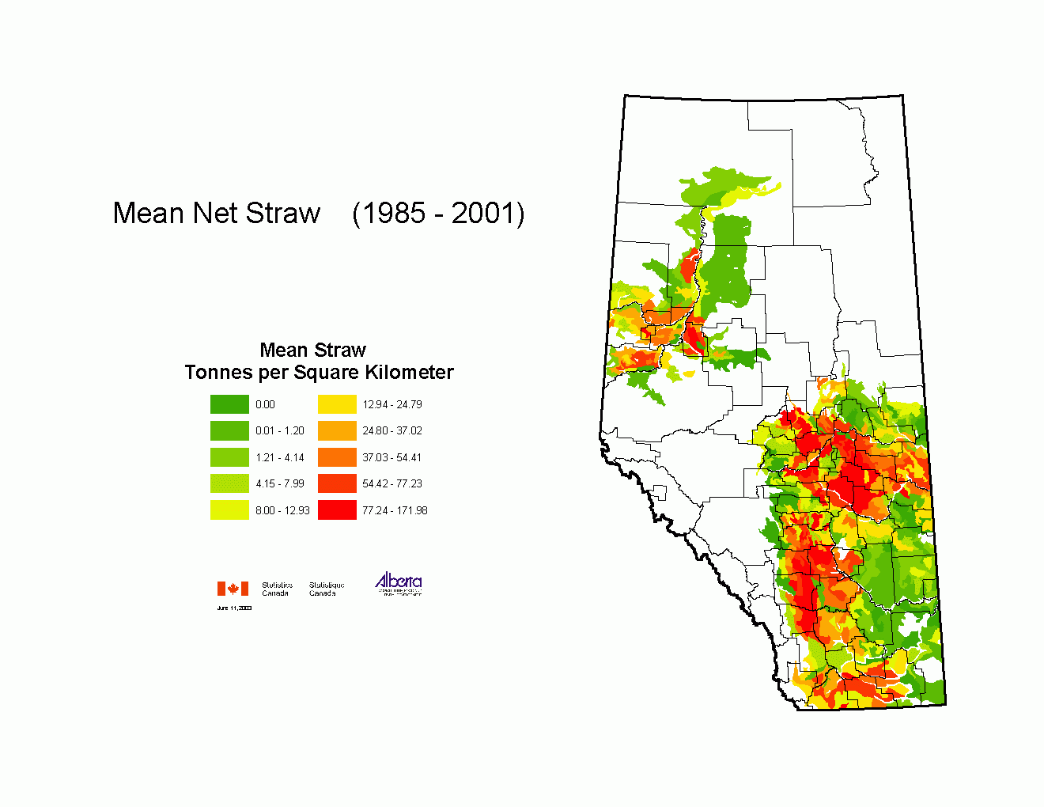
Biomass Opportunity
Alberta Scenario
  Agricultural Area Area
Crop Type | Acreage
Spring & Winter Wheat | 6,467,628
Canola | 4,068,511
Barley | 4,094,689
Alfalfa and mixtures | 3,935,022
Other tame hay | 2,060,967
Corn for Silage | 70,411
Triticale | 76,299
SO: Government of Alberta, ARD Census Data (2006)
6

Slide 7
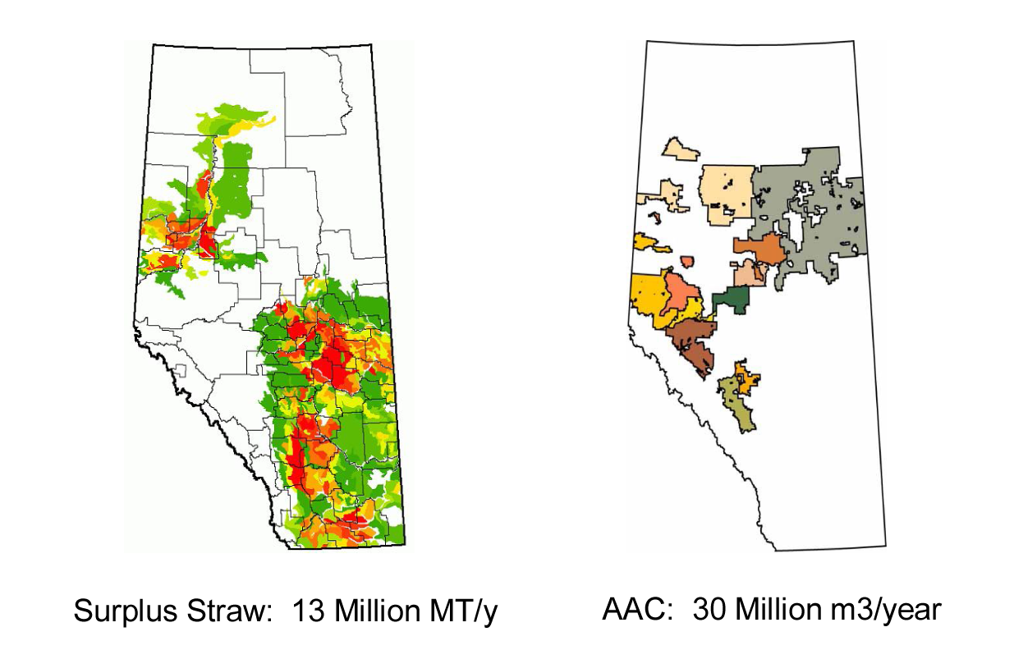
Biomass Opportunity
Alberta Scenario
SO: Government of Alberta, ESRD
7

Slide 8
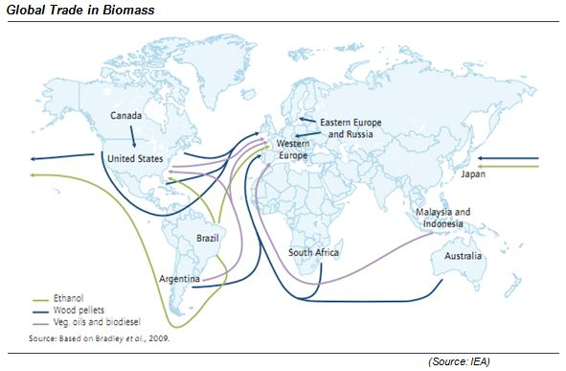
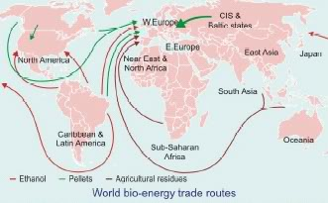
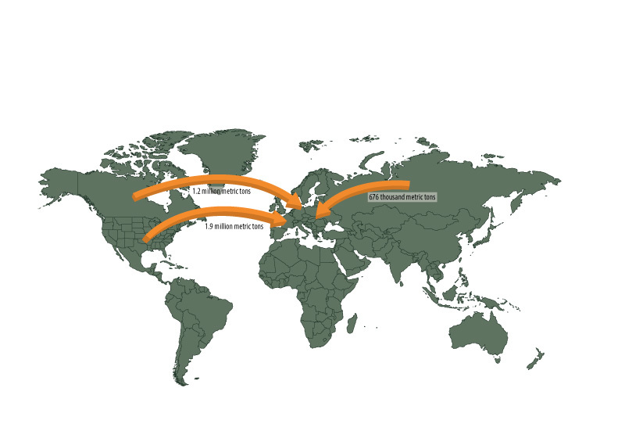
http://www.navigantresearch.com/tag/biofuels?page=9
http://news.mongabay.com/bioenergy/2007_04_11_archive.html
http://biomassmagazine.com/articles/9467/domestic-global-outlook

Slide 9
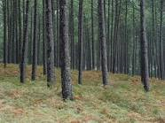
Technology is Changing Industries
Emerging Forest Products
CHEMICALS & MATERIALS
Nano-Crystaline Cellulose
Bio Active Paper
Biooils
Textiles
Renewable Rubbers
Bioplastics
Methanol
Building Material
Energy
Pulp & Paper
FUELS
Cellulosic Ethanol
Aircraft Fuel
Renewable Diesel
OTHERS
Food Additives
Pharmaceuticals
Notes:
There are many product streams as a result of research and development
The potential for these diversified, value-added streams will continue to be based on the economics of producing these from existing forest sector operations;
greenfield production is not viable at this point – best economics involve adding to existing facilities
forest sector are experts in getting fibre to facilities, in most efficient and cost-effective way
Forest sector has changed from pulp, paper, lumber to a complex industry with some 40+ product streams
including significant volumes of green energy – not just from kraft pulp mills, but also co-generation at sawmills

Slide 10
Alberta Bioindustry
Drivers:
  Policy and regulations
    (GHG reduction, renewable fuel standard)
  Price volatility, diversify markets
  Rural development
  Some traditional industries are in peril, enhanced agricultural and forestry productivity
  Recognition that we have all the resources necessary to become a global leader in bioindustrial technology
10

Slide 11
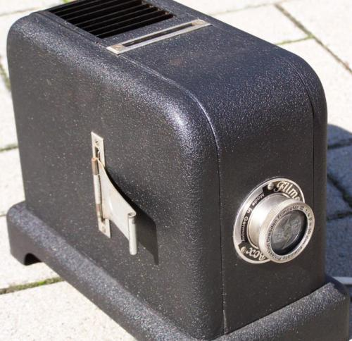
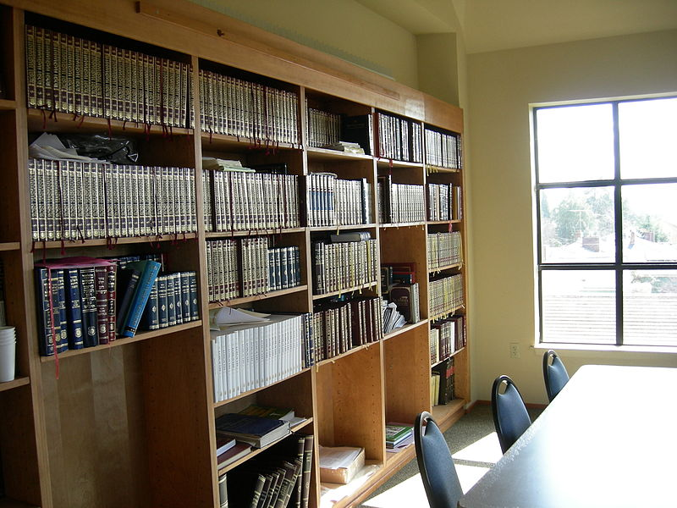

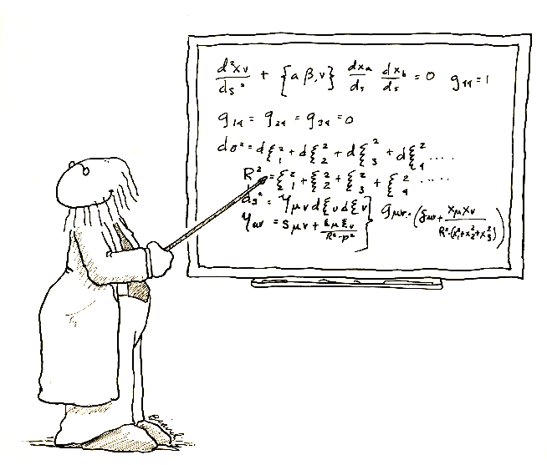

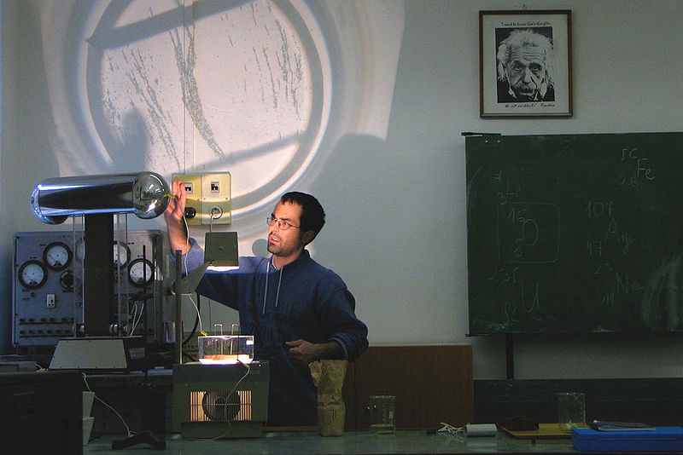
History of Academia – Industry Interface
http://commons.wikimedia.org

Slide 12
Institutionalization of Partnerships…
“We are the experts, if they want the info, they will have to come to us…”
“We have needs and teaching the next generation is a higher calling, how can industry serve us…”
“Some academics can’t speak the right language, so we better put a development officer in to translate…”

Slide 13
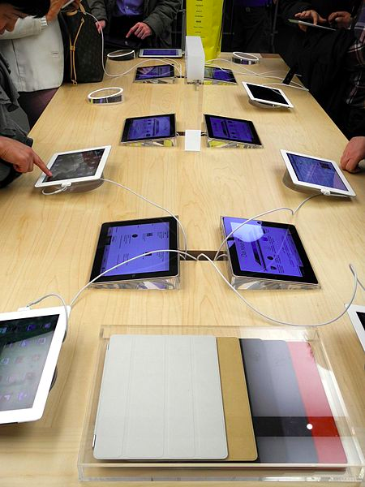


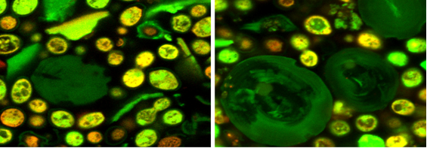
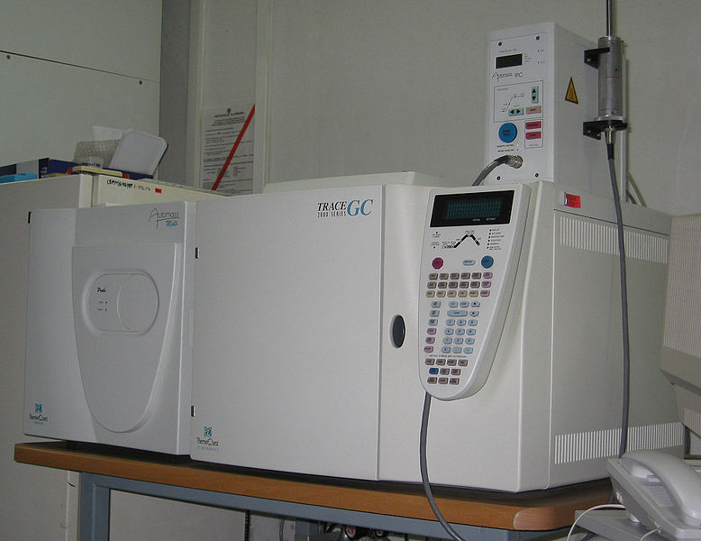
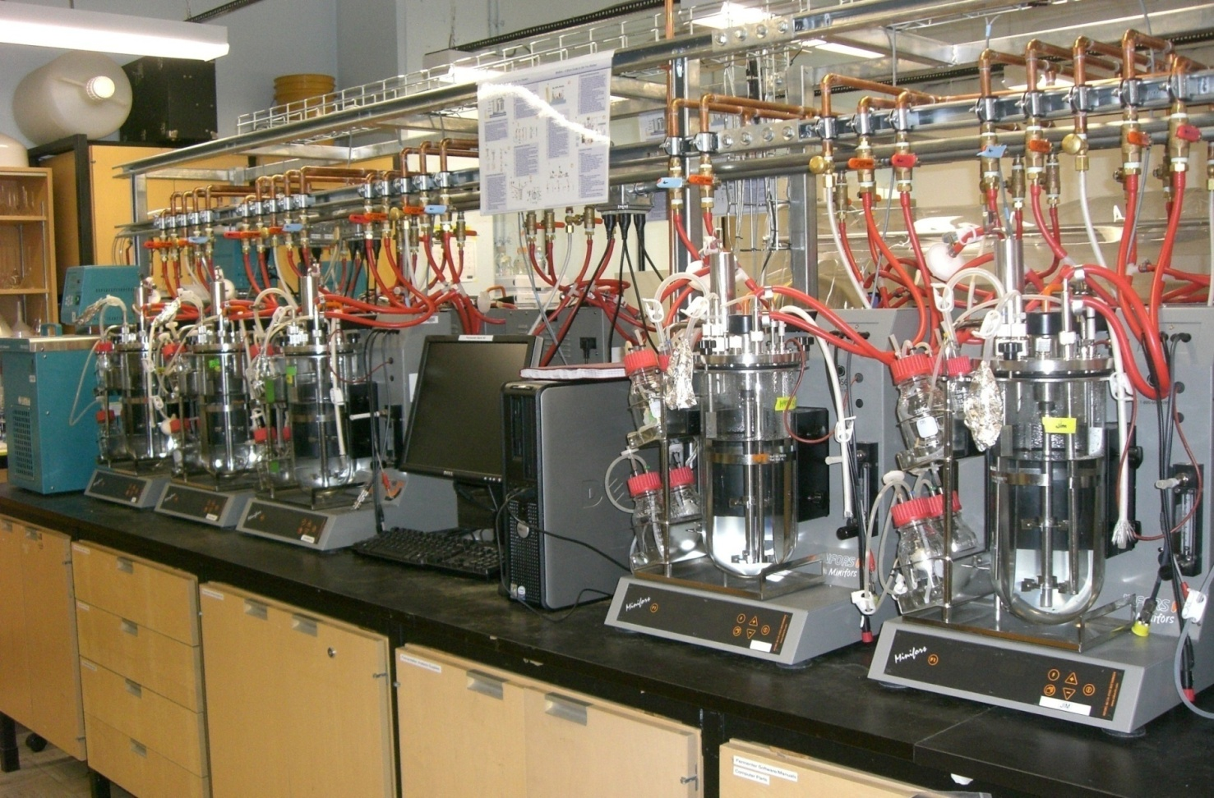

Modern Academia
http://commons.wikimedia.org

Slide 14
The traditional way of pursuing Strategic Research and Innovation…
Open Call, Peer Reviewed Funding Agency Call for Proposals
Selection based on Academic Excellence
Seek industry “matching” to demonstrate road to commercialization and relevance of research

Slide 15
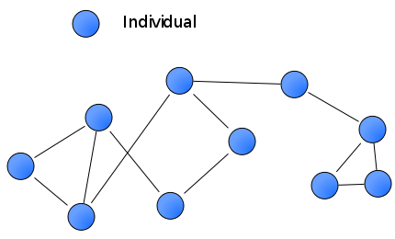




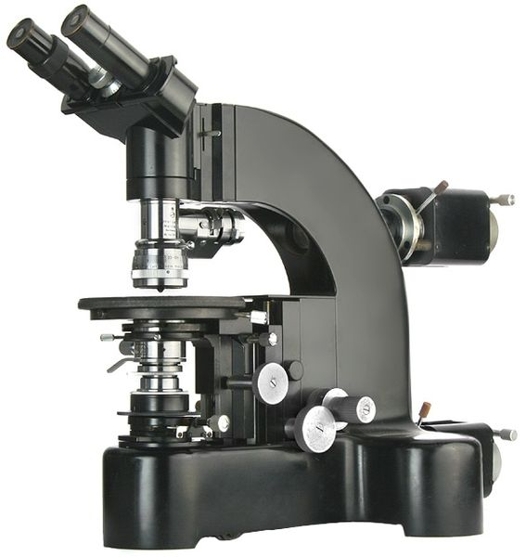
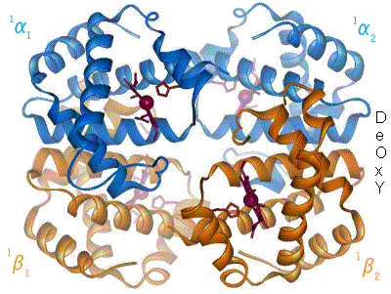





Modern Networks

Slide 16
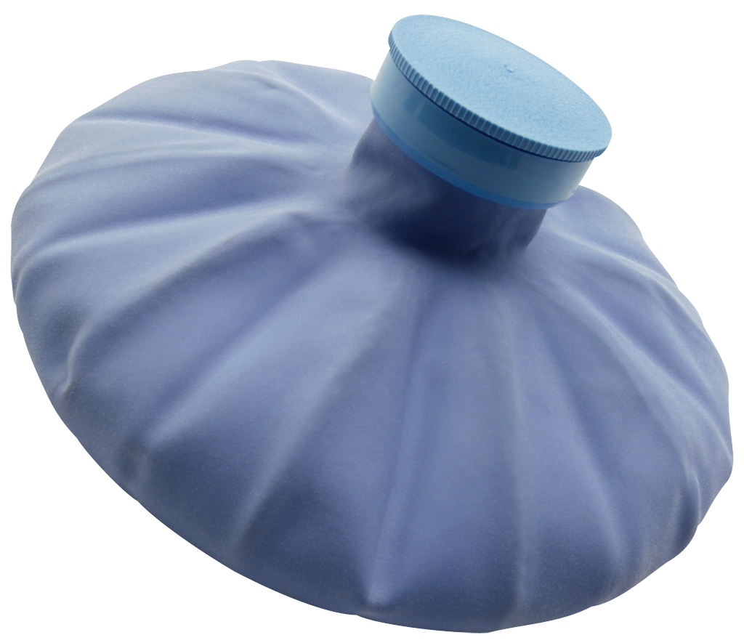
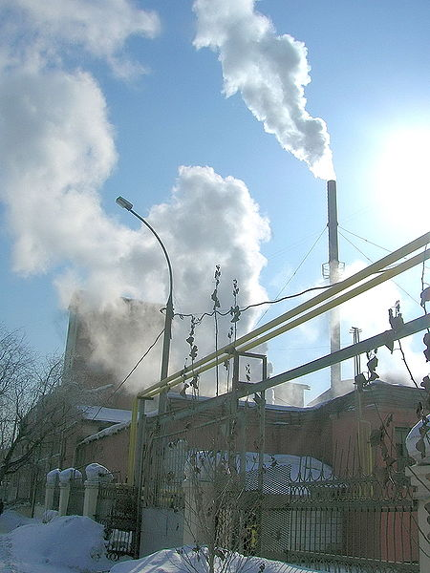
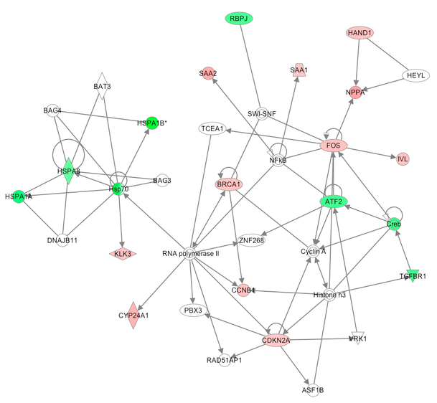
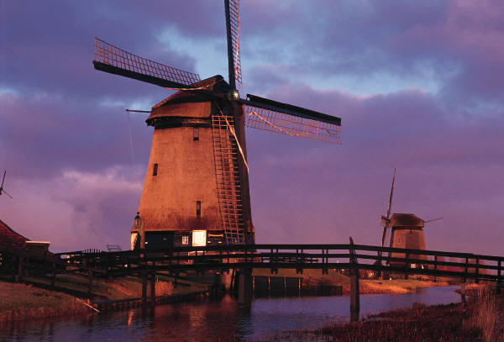
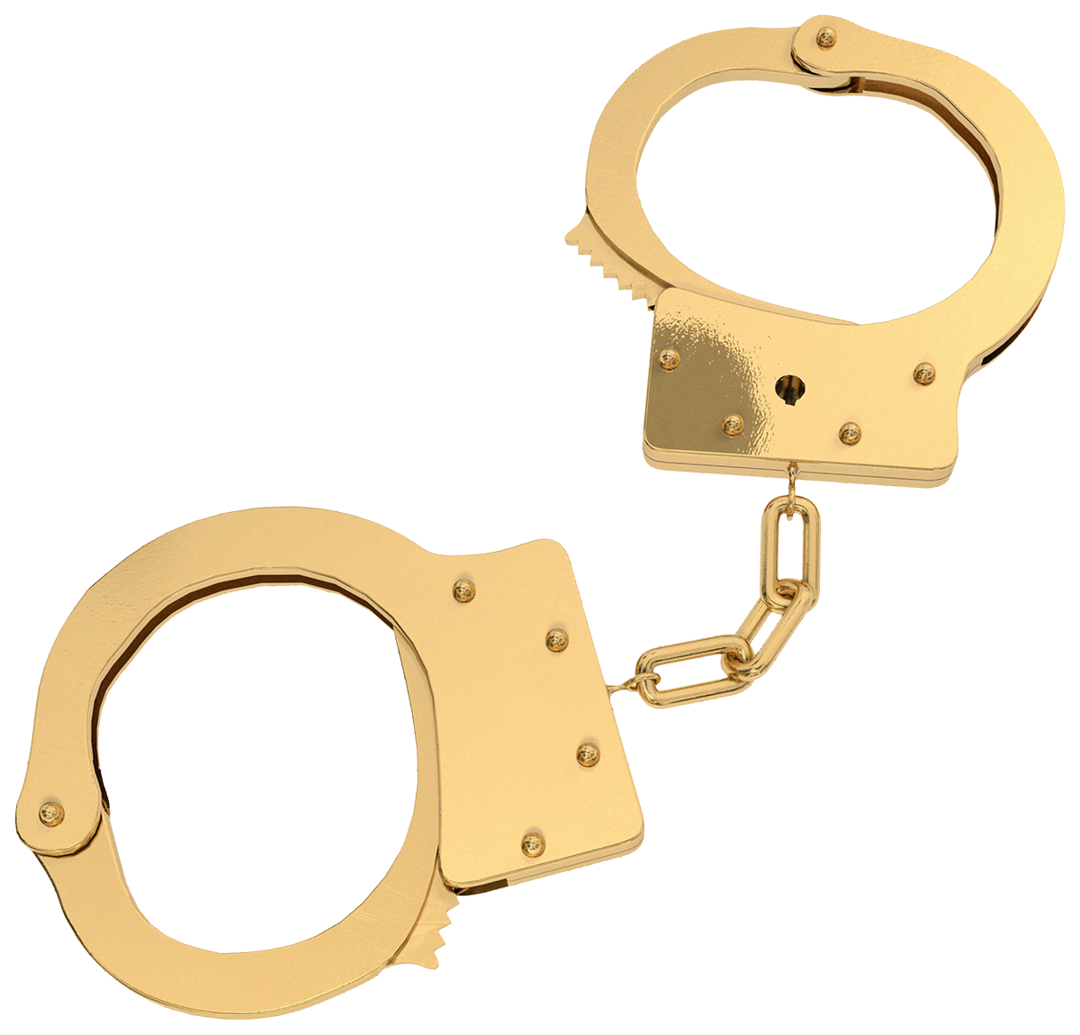



Modern Networks – Open Innovation

Slide 17
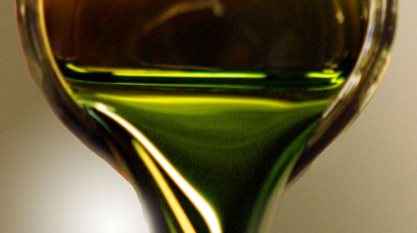
What is Intellectual Property to a Scientist?
Service (computer code, facebook)
Widget (IT sector (Blackberry), Pharma (vaccine), New crop varieties
Process (Clark Hot Water Extraction)
Source: Photo http://blogs.tnr.com/tnr/blogs/environmentandenergy/greencrude.jpg
17

Slide 18
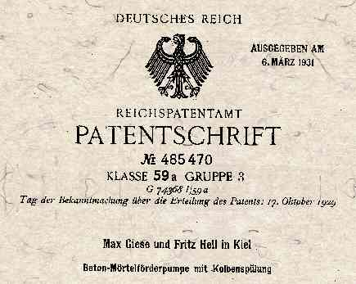
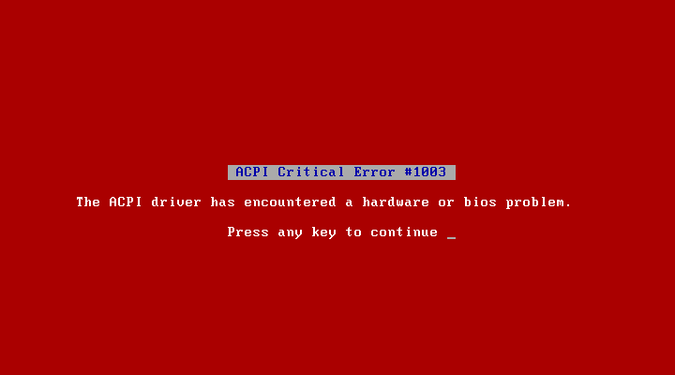

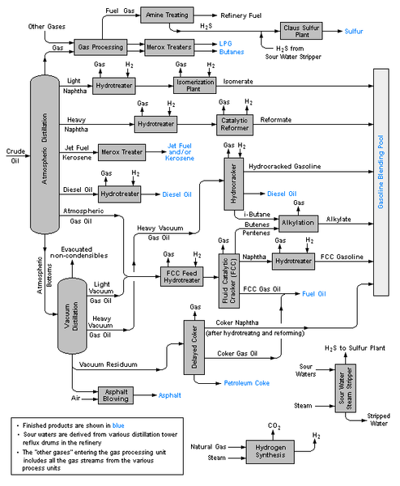
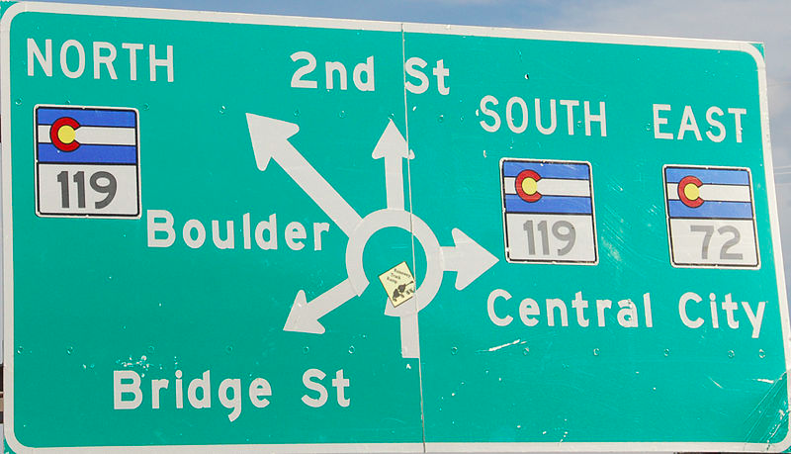

Research Transition Offices
http://commons.wikimedia.org
“The more you have failed, the more investible you are…??!!”

Slide 19
Issues with traditional Strategic Research and Innovation…
Pit academics against each other
Harass industry partners at too early of a stage
Never see key strategic projects of industry partners
Negotiate value of research to industry before value assessed
Lose regional leverage over industry (if large) before even starting program

Slide 20
RECENT HISTORY OF BIOINDUSTRIALS
2000-2006:
  Hope for new value for Agriculture and Forestry
2003-2010:
  Antagonism with the Energy Sector
2005-2007
  Provincial support and programming
  (9 point energy plan)
20

Slide 21
RECENT HISTORY OF BIOINDUSTRIALS
2007-2009
  Financial Crash
2009-2010
  Renewed interest in sector
  Refocus on biorefining/chemicals
2012-Current
  Shale gas impact?
21

Slide 22
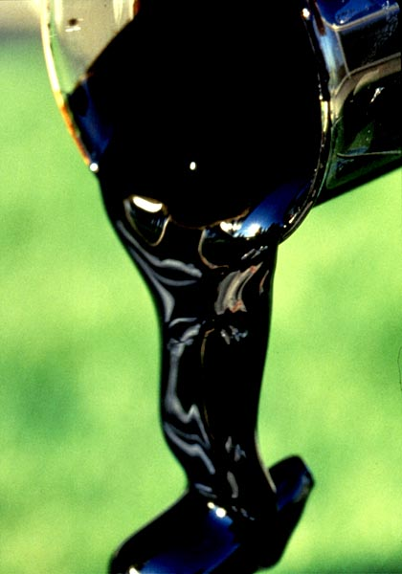
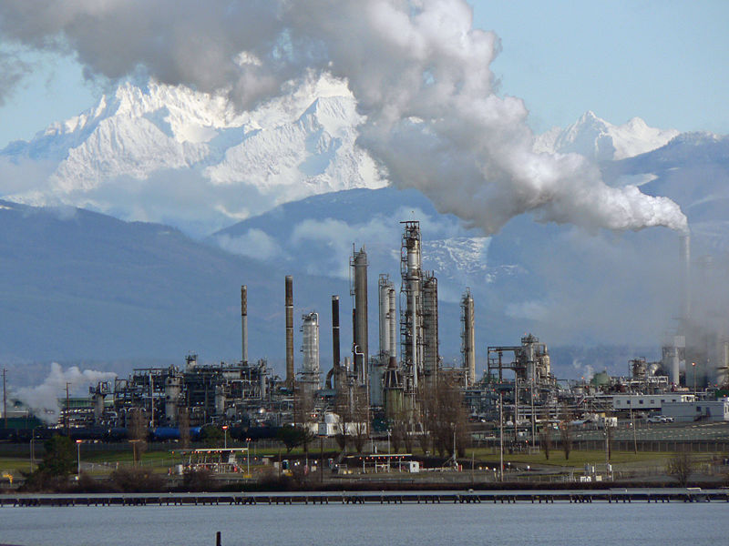
Stereotype Visions of
the bioindustries
  We will replace petroleum
  We will augment petroleum
  We will get policy that will impose us on petroleum
  We will find a niche (where they can’t find us)
Source: Top photo, Syncrude, 2010
22

Slide 23
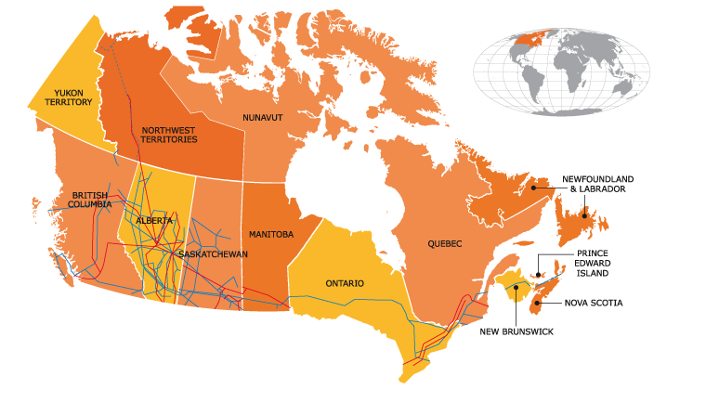
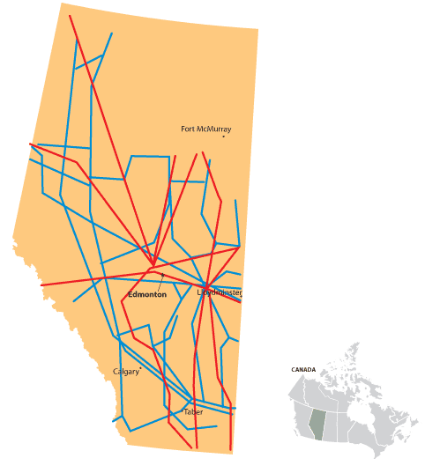
Current Industrial Infrastructure
Alberta Scenario - Pipeline
The Alberta “hub” includes 392,608 kilometres of pipeline that
deliver oil and gas to markets in Canada and the U.S (Alberta Energy)
SO: Center for Energy (2010)
23

Slide 24
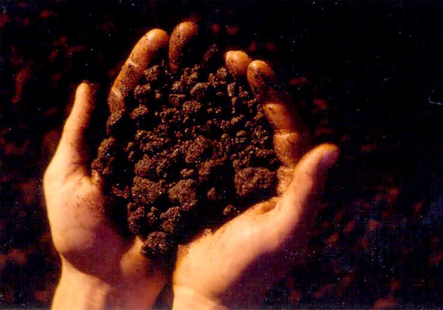
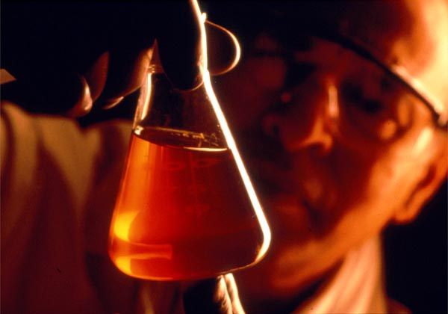

http://www.syncrude.com/syn_library/images.html

Slide 25
Seizing the Opportunity
Petrochemicals as a Model
Majority of fuels and industrial chemicals are currently derived from crude oil refining
Large scale natural gas conversion to liquids by 2010
Oil Sands
Bitumen
Fuels
Gases
Crude Oil
Industrial
Chemicals
Liquids
Heavy Liquids
Specialty
Chemicals
Natural Gas
Notes:
25
25
With the world’s petroleum resources being depleted at an alarming rate, we have a tremendous opportunity to utilize our renewable resources in a manner similar to the petrochemical industry where we can fractionate our crops into their components, convert and utilize them in literally thousands of products.

Slide 26
Variation in Conversion Processes
Direct combustion
Electricity
Syngas
Gasification
Thermo-chemical Conversion
Pyrolysis oil
Fast Pyrolysis
Heat
Conversion Process
Others
Fuels
(e.g., diesel, H2)
Biological Conversion
Chemicals
Chemical Conversion
(Kumar, 2013)

Slide 27
Complexity of the Challenge
(Kumar, 2013)

Slide 28
BioBased Products:
Mapping by Technology

Slide 29
Landscape of Biobased Chemicals
 | C3 and below | C4-C6 | C7 and above
Biotech | NatureWorks (PLA), Novozymes (propanol) DuPont (1,3-pdo) Calysta (lactic)* Several (ethanol) | BioAmber and others (succinic), Genomatica (BDO), Green Biologics (butanol), Gevo and Butamax (isobutanol) DuPont/Goodyear, GlycosBio* (isoprene) Global Bioenergies (olefins) Metabolix (PHBs) Verdezyne (adipic)* | Cathay (C12+ diacids), Verdezyne (C12 diacid)* Amyris (farnesene), LS9 (fatty alcohols) Solazyme (oils)
Combined | Cargill/BASF/Novozymes and OpX (acrylic) Dow/Mitsui (ethylene) Braskem (propylene) | BioAmber (BDO), Ascenix, Evonik, Lucite (MMA) Amyris, Gevo (PTA)
Chemistry | Solvay (epi)* Novomer (acrylic)* | Avantium (FDCA), Rivertop Renewables (glucaric), Segetis (levulinic derivatives) Rennovia (adipic) Virent, Anellotech (xylene) | Elevance (C18)*
*indicates non-carbohydrate feedstock based

Slide 30
Alberta’s Major Exports 2012*
Total Exports of Goods ($94.8 Billion)
$ Billions
* Exports of services are not included in this estimate
Sources: Statistics Canada and Alberta Innovation and Advanced Education
Notes:
In 2010, Alberta exported $77.8 billion worth of goods and services to 189 countries, an increase of 7.3 per cent from the value five years ago.
Alberta’s exports declined in 2009 as a result of both lower commodity prices and volumes, for instance for energy products. Alberta exports an increasing volume and variety of manufactured products such as petrochemicals and metals and machinery . Exports in manufactured products increased strongly between 2004 and 2008 but faced deteriorating global markets in 2009. However these are expected to pick up in the future.

Slide 31
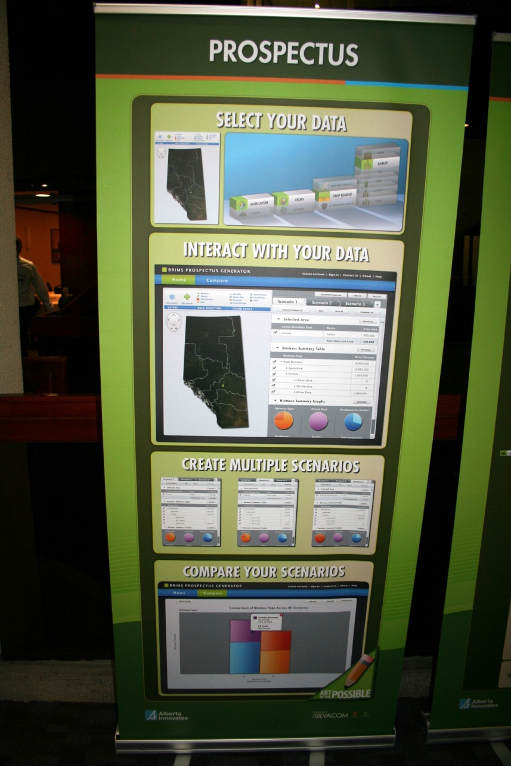
BioEconomy Strategy
For Alberta
10 year strategy building toward a 20 year horizon
  Strengths of agriculture and forest industry
  Diversifying through linkages to the oil and gas sector, i.e. using biobased solutions to solve current issues.
  Near term opportunities in CO₂ and GHG reduction, sequestration and offsets, biopolymers and green fluids (fracking fluids)

Slide 32
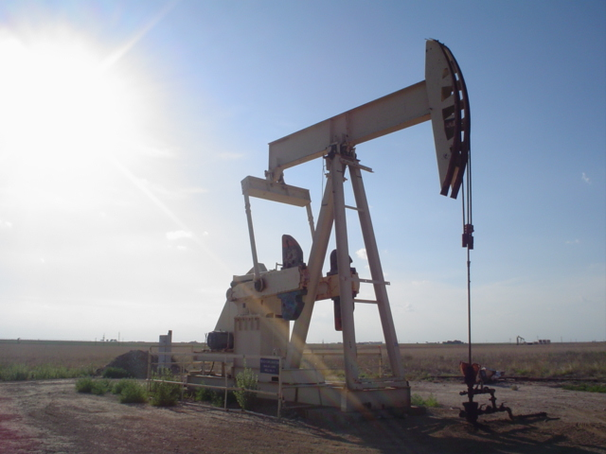
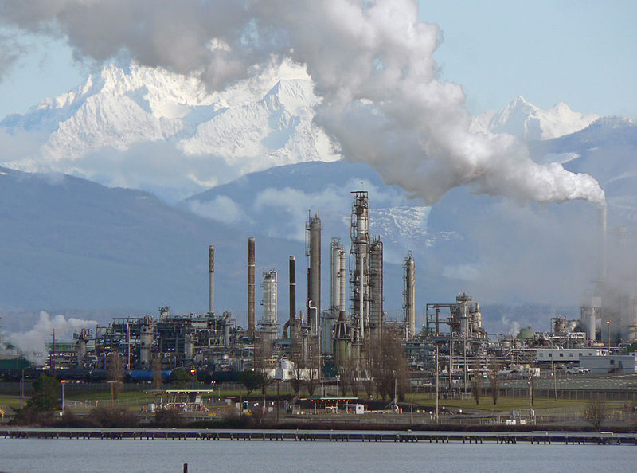
Sector Integration
Forestry
Agriculture
Bioindustrial Sector
Oil & Gas
Petrochemical
Integrating traditionally separate sectors to create a unified bioeconomy
32

Slide 33
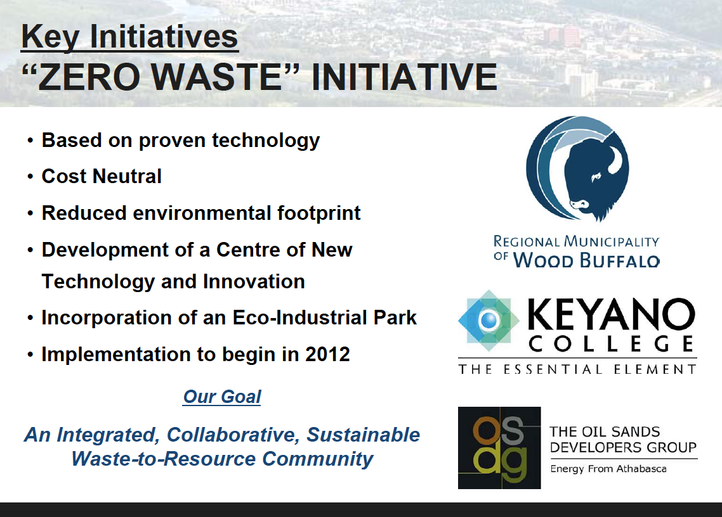

Slide 34

Traditional academia in support of the evolving bioeconomy
“You can’t get there from here…”

Slide 35

Why industry is still at the table
True expertise (skillsets) they don’t have
Tax breaks on research
Infrastructure
New ideas
Ability to work on high value, low probability of success approaches

Slide 36




Bioindustrial Innovation Division
Focuses on new chemicals, materials and energy from agriculture, forest and municipal solid waste biomass
Offers targeted funding, advice and connections
Supports 29 active R&D projects worth $63 million in total project costs
Some projects involve:
Biorefining Conversions Network, energy LCA, drilling mud, biochar, biocomposites
Invites companies to become R&D partners with Alberta Innovates Bio Solutions
Some R&D partners:
Notes:
Alberta Innovates Bio Solutions is a research agency funded by the Government of Alberta.
It invests in science and innovation to grow prosperity in Alberta’s agriculture, food and forest sectors through new technologies, products, services or industry practices.
It routinely seeks R&D partners in the areas of sustainable production, bioindustrial innovation, food innovation, prion diseases and ecosystem services.
It offers targeted funding, advice and connections.
Its bioindustrial innovation division focuses on value-added products, including biomaterials, biocomposites, biochemical and bioenergy, all of which hold significant potential to develop into competitive clusters.
Some technologies being explored through AI Bio’s bioindustrial innovation division that may broaden Alberta’s economic base while balancing conservation, biodiversity and ecological resilience are: developing state-of-the-art biomass estimation systems; innovative biomass conversion technologies; cellulose nanocrystal extraction and applications development; extraction and purification of numerous high-value-added bioproducts; bioremediation of oil sands tailing ponds, water management and purification; support for research into new approaches to building construction and developing new building products and systems; and support in developing codes and standards related to biocomposites, biochemicals and biomaterials.
Collaboration is important to AI Bio and enhances ability to build on each partner’s strengths, leverage resources and better address industry challenges.
Some R&D partners involved in bioindustrial innovation projects include:
Cenovus, a partner in project BIO-12-011, Amit Kumar’s chair Natural Sciences and Engineering Research Council of Canada/Cenovus/Alberta Innovates Associate Industrial Chair in Energy and Environmental Systems Engineering.
Novozymes, a partner in project BIO-12-014 Enzymatic Enhancement of Natural Fibres for Composite Applications
Champion Technologies and Suncor, partners in Dr. Mitlin’s project BRI13050 Cost-Effective Biochar Adsorbents for Naphthenic Acid and Total Organic Carbon Removal in Oilsands Tailings
For more information on these projects, visit www.BioLINK.albertainnovates.ca and search for the project number.

Slide 37
BCN Mission
  How do we best use our solar energy units per hectare of land to best meet our needs for food, materials, energy and not be …
  “Hewers Of Wood And
  Drawers Of Water”
Source: Top photo, Syncrude, 2010
37

Slide 38
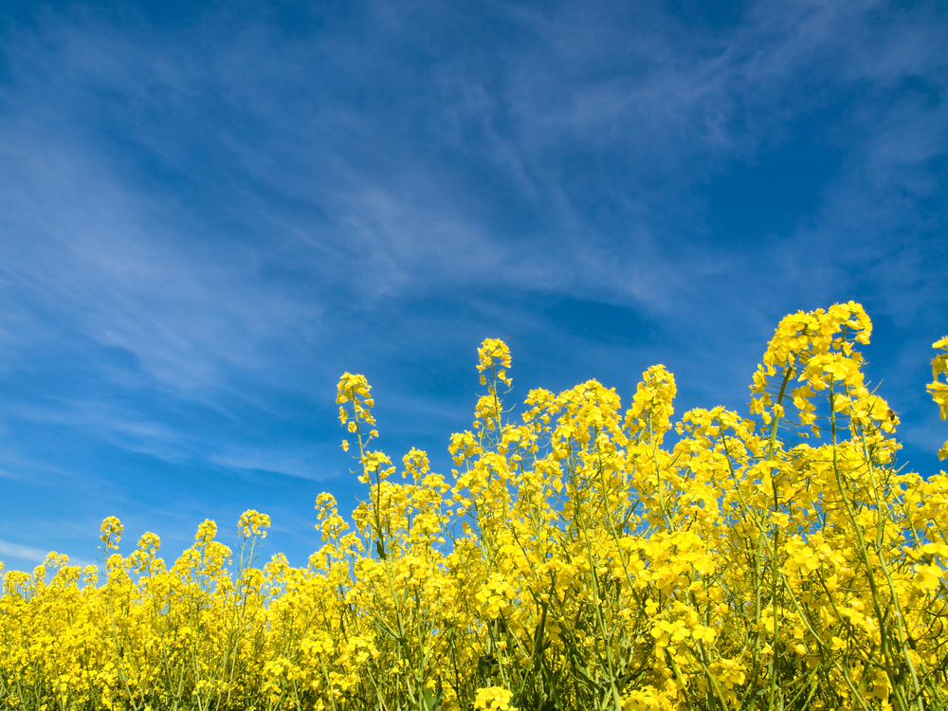
Mandate
Play a pivotal role in cultivating Alberta’s bioindustrial sector by facilitating development of novel, commercially viable biomass conversion technologies and value-added products

Slide 39

BCN at a glance
Inclusive research network based out of the U of Alberta
Funded by AI Bio Corp. (C$ 3 million over 3 years, then $4+M 2012-2015)
Focused on biomass conversions, developed to bridge the gap between feedstock processing and product distribution to accelerate the commercialization process

Slide 40
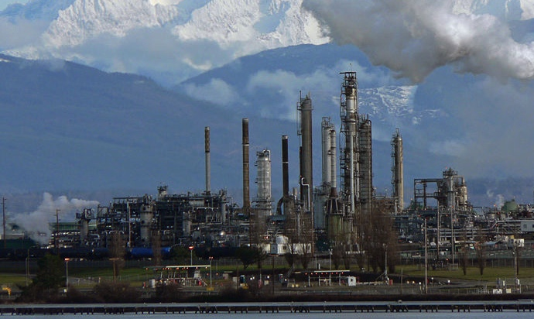
BCN Mission
  Develop “drop-in” chemicals and products that support Alberta’s nonrenewable sector
    Renewable products to service the industry
    Compatible with petroleum products
    Hydrocarbon fuels, non-oxygenates
        Integrate into existing infrastructure
  Alberta has already invested billions in oil and gas infrastructure
Source: Top photo, Syncrude, 2010
40

Slide 41

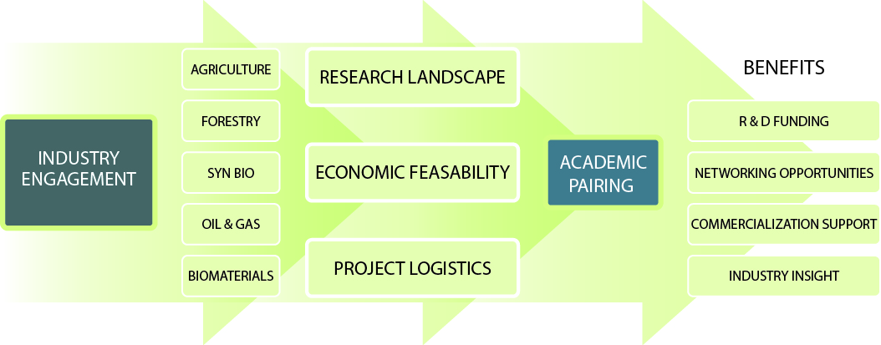
THE BCN MODEL
BCN facilitates multidisciplinary industry-academic collaborations that emphasize innovation and commercialization

Slide 42
Successful Industry Engagement
Industry Needs 3 Elements for Successful Engagement:
Security of key ideas
Rapid Response and Deployment
Trust relationships
  Direct contact
  Creative interaction
  Online support and consultation

Slide 43
BCN Core Research
Core research focuses on biorefining conversions
Four research themes
lipids
Thermal conversions
Chemicals & solvents
proteins
Bioenergy & biofuels
Biomass
Pre-Processing
& Separations
starch
chemical conversions
Downstream processing
Cosmetics & personal care
fibre
Biomaterials &bioplastics
bioactives
Biological conversions
Foods & nutraceuticals
43

Slide 44
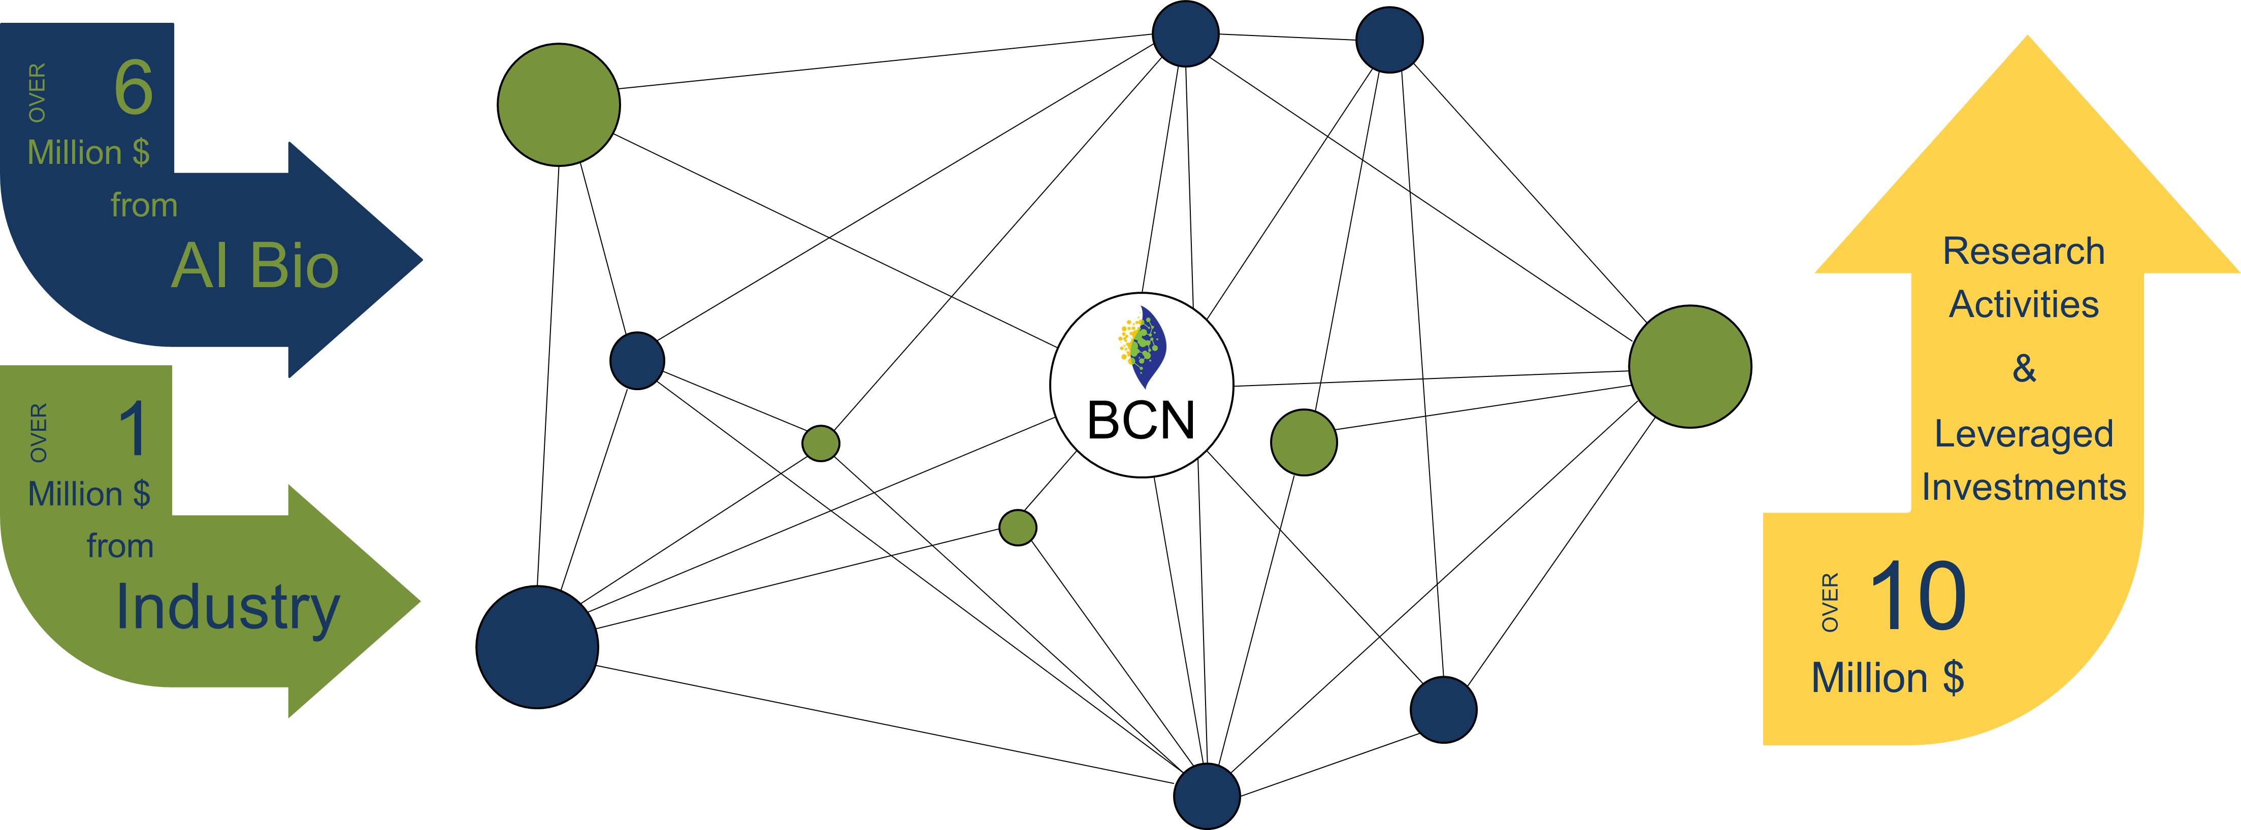
BCN: levering investments

Slide 45
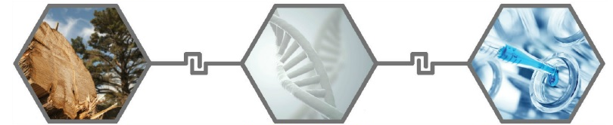
BCN projects focus on 3 themes:
Byproducts Utilization
Synthetic Biology
Chemical Platforms
Value-add Opportunities
Biocatalysis & Fermentation
Advanced Bioproducts

Slide 46
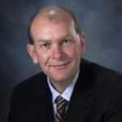
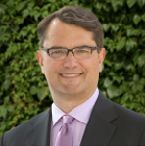










BCN Strategic Advisory Board
CHAIR: Brad Anderson
Executive Director
Alberta Chamber of Resources
Stan Blade
CEO, AI Bio Solutions
Ken Chapman
Executive Director,
Edmonton Economic
Development Corporation
Eddy Isaacs
CEO, AI Energy
and Environment
Jack Saddler
FPB Bioenergy
UBC
Steve Price
Executive Director
AI Bio Solutions
John Kennelly
Dean, U of A
Faculty of ALES
David Bressler
BCN Executive Director
Norm Dreger
Head, Business Development,
Syngenta
Ray Miller
CBO Verdezyne Inc.
Donald Smith
Professor McGill
Director BIOFUELNET
David Layzell

Slide 47


R&D: ~$2M
BCN 2.0 Budget
Core ~ $1.8M

Slide 48








BCN Scientific Committee
Dr. Kevin Hicks
Research Leader
ARS, USDA
Dr. Peter C.K. Lau
Principal Research Officer
National Research Council
William Orts
Research Leader
ARS, USDA
Dr. Warren Mabee
Canada Research Chair (Tier 2)
Queen’s University
Emma Master
University of Toronto
Theodore H. Wegner
Assistant Director
Forest Products laboratory
USDA Forest Service
Kelly Maher
BCN Director
Program Development
David Bressler
Executive Director
Christine Murray
Director
AI Bio Solutions

Slide 49






Byproducts Utilization and Value-Add Opportunities
Strong Collaborations with Alberta Forestry Industry
Mapping and Quantitation of Forestry Waste Streams
Tall Oils
to Fuels
Lignin Chemistry
Terpenes
Cellulose Nano-Crystals
Forest Ash Characterization & Utilization
Massive opportunity to integrate with traditional resource industries in Alberta

Slide 50


Synthetic Biology: Biocatalysis and Fermentation
Hardest to tackle, but most rewarding
Phenylalanine derived chemicals
Microbial Biosynthesis of Fatty Alcohols
Upcycled Aromatics
Biopolymers from C1 Substrates
Biodensification of Oil Sands Tailings
Specialty Chemicals
Submitted a grant for a $12M high-throughput synthetic biology centre

Slide 51




Advanced Bioproducts and Chemical Platforms
Bio-based materials: most mature sector in bioindustry?
Bio-Nonanal from Plant Oils
Bio-polymers
Novel Flocculants from Agricultural Waste Proteins
Biodiesel- Derived Glycerin
Polysaccharides for Naphthenic Acid Extraction from Tailings
Epoxies
Lignocellulose Subfractionation

Slide 52
Biomass Pre-Processing
& Logistics
Biocatalysis & Fermentation
Green Chemistry for
Fuels & Chemicals
Program 1
Program 3
Forest-Derived
Fly Ash Upgrading
Lignocellulosic Separations
Polysaccharides for Naphthenic Acid Extraction from Tailings
Supercritical Fluids: Extracting Gels from Lignocellulosic Biomass
Standardization of Lignocellulosic Fractions
Tall Oils
to Fuels
Tailings Flocculants from Agricultural Waste Proteins
Terpenes
Bioaldehyde Production from Plant Oils
Aromatic Compounds from Cellulosic Waste Streams
Algae-Derived Chemicals
Program 2
Hemicellulose
to Xylitol
Accelerated Biodensification of Tailings
Biopolymers from C1 Substrates
High-Value Fatty Alcohols
Synbio Manucturing of High-Value Phenylalanine-derived Specialty Chemicals
Microbial Conversions to Reduce Heavy Oil Viscosity

Slide 53



2014 BCN Retreat
October 21-23, 2014,
Fairmont Banff Springs Hotel,
Banff, Alberta, Canada
Fairmont Banff Springs Hotel
Mobilizing Alberta's Bioeconomy

Slide 54













Industry-Driven Partnership for
Value-Chain Optimization,
Economic Expansion and Enhanced Environmental Performance
... OTHERS WELCOME!!

Slide 55







BCN Highlights
International R&D
USA
(DOE, USDA, Florida,
California, Midwest)
  Germany
  (CLIB2021)
  Netherlands
  (TU Delft)
  Finland
  India
  Japan
55

Slide 56



Learn more and contact us:
http://www.bioeconomyalberta.com
http://www.bcn.ualberta.ca
http://bio.albertainnovates.ca
Funded by the Government of Alberta
*

Slide 57




Thank-You
Questions?
For further info, please contact:
David Bressler
410 Agriculture Forestry Bldg.
University of Alberta, Alberta, Canada. T6G 2P5
David.bressler@ualberta.ca, Tel# 1 (780) 492 4986
57

